Slide 1
Global Perspectives in Real Estate
March 30, 2020 (Part 1)
Return Opportunities

Slide 2
Where this Lecture Fits in the Structure of the Course
Geltner, Miller, Clayton and Eichholtz (Chapter 24); “Geltner et al.”
There’s a Big World Out There (24.1)
Global Real Estate Market: Size and Flows (24.1.1)
Institutions of Globalization (24.1.2)
Going International (24.2)
Return Opportunities (24.2.1)
International Diversification (24.2.2)
Managerial Considerations (24.2.3)
Obstacles to International Property Investment (24.2.4)
Developing and Implementing International Real Estate Strategies (24.3)
Public Real Estate Investment (24.3.1)
Determining Country Allocation (24.3.2)
The “Home Market” Concept (24.3.3)

Slide 3
In addition to Geltner et al. (24.2.1), this lecture is based on Ahir and Loungani (1) …

Slide 4
… and Ahir and Loungani (2)
Chapter 7 in this book

Slide 5
The Framework for understanding Return Opportunities (24.2.1)
Going International (24.2)

Slide 6
Framework to Understand Return Opportunities

Slide 7
Trend or structural opportunities (Long run)
RETURN OPPORTUNITIES

Slide 8
Global House Prices: the Trend

Slide 9
Global House Prices:
The Global Financial Crisis interrupted the trend

Slide 10
Return Opportunities:
Structural (Long Run) Factors Driving the Trend in House Prices
Traditional factors
Demand:
      Demographics
      Economic growth
      Urbanization
      Development of financial markets (credit availability)
  Supply:
      Building costs
      Zoning & other regulations

Slide 11
The trend in house prices has gone hand-in-hand with increasing mortgage finance

Slide 12
Return Opportunities:
Structural Factors in the Future?
  Office space: work from home?
    Is Coronavirus nail in coffin of WeWork?
  Retail space: online purchasing?
  Changes in preferences toward home ownership?
  Other trends?

Slide 13
Cyclical opportunities
(“Short” run)
RETURN OPPORTUNITIES

Slide 14
Return Opportunities:
Cyclical Factors Driving Real Estate
Short-run fluctuations in ‘traditional factors’:
  Business cycles & crises (sometimes induced by previous exuberance in real estate markets themselves)
  ‘momentum’ effects (particularly if supply is inelastic)
  New element: active response by policymakers to “tame” housing cycles
Real estate cycles
  Some regularities, but notion of “property clocks is misleading” (Geltner et al., p. 617)

Slide 15
Duration and Amplitude of Cycles

Slide 16
Dating Cycles

Slide 17
Stylized Facts about Housing Cycles

Slide 18
During cycles, house prices & investment: tend to go up together ...
120
Change in Housing Prices and Residential Investment 2000-06
100
ESP
80
FRA
GBR
DNK
60
IRE
CAN
SWE
ITA
NOR
Housing prices
40
USA
FIN
20
CHE
0
-20
0
20
40
60
80
100
DEU
-20
-40
Residential Investment

Slide 19
… and down together
4
Change in Housing Prices and Residential Investment 2007-08
CHE
2
0
-35
-30
-25
-20
-15
-10
-5
0
5
10
FRA
DEU
-2
SWE
ITA
Housing prices
-4
FIN
CAN
ESP
IRE
DNK
NOR
-6
USA
GBR
-8
-10
Residential Investment

Slide 20
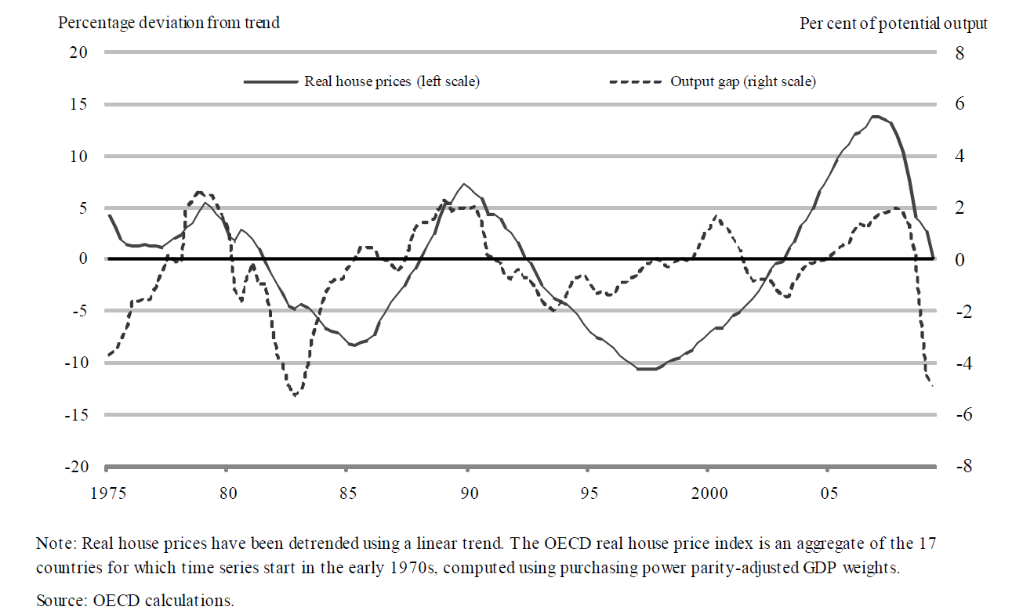
Short Run Drivers:
House Prices and Output Gaps
Source: André, C. (2010), “A Bird's Eye View of OECD Housing Markets”

Slide 21
Short-Run Drivers: Interest Rates

Slide 22
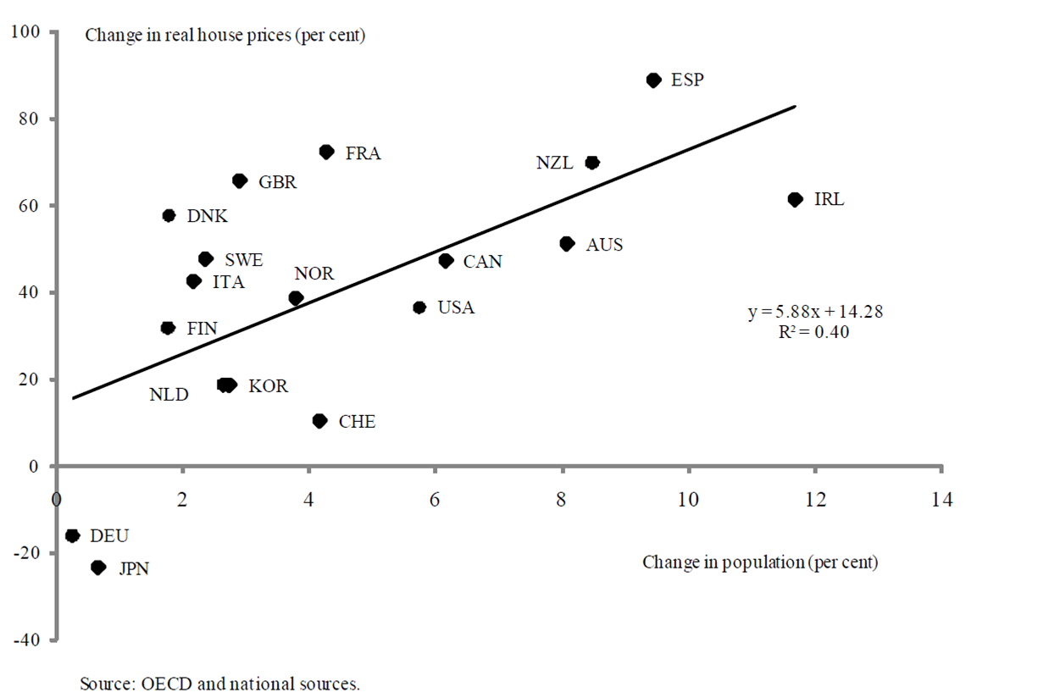
Short-Run Drivers:
Real House Prices & Population

Slide 23
New element: more active response by policymakers to housing booms through macroprudential policies
Loan-to-value ratio (LTV)
Limits on LTV ratios impose a cap on the size of a mortgage loan relative to the value of a property, thereby imposing a minimum down payment.
Debt-to-income ratio (DTI)
Caps on DTI ratios restrict the size of a mortgage loan to a fixed multiple of household incomes, such as 40%, thereby containing unaffordable and unsustainable increases in household debt.

Slide 24
Traditional policies to manage housing cycles

Slide 25
New element: macroprudential policies

Slide 26
Growing use of macroprudential policies

Slide 27

Country experience: Korea
Gangnam area = Speculative Zone
House price appreciation in Gangnam area

Slide 28
Long Run Anchor? House Price to Income

Slide 29
Long Run Anchor? House Price to Rents

Slide 30
How WELL does the Framework Perform?
RETURN OPPORTUNITIES

Slide 31
Estimation of the Framework

Slide 32
Prediction vs. Reality: Test of the Framework

Slide 33

Synchronized Sinking?
PRE-CORONA
Outlook for
Housing Markets
Around the World

Slide 34
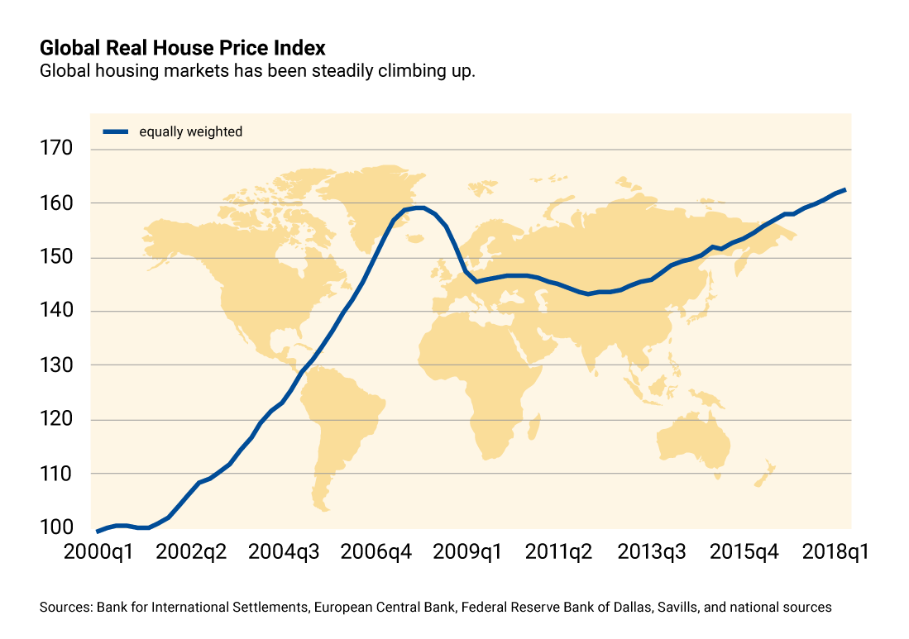
IMF Global House Price Index

Slide 35

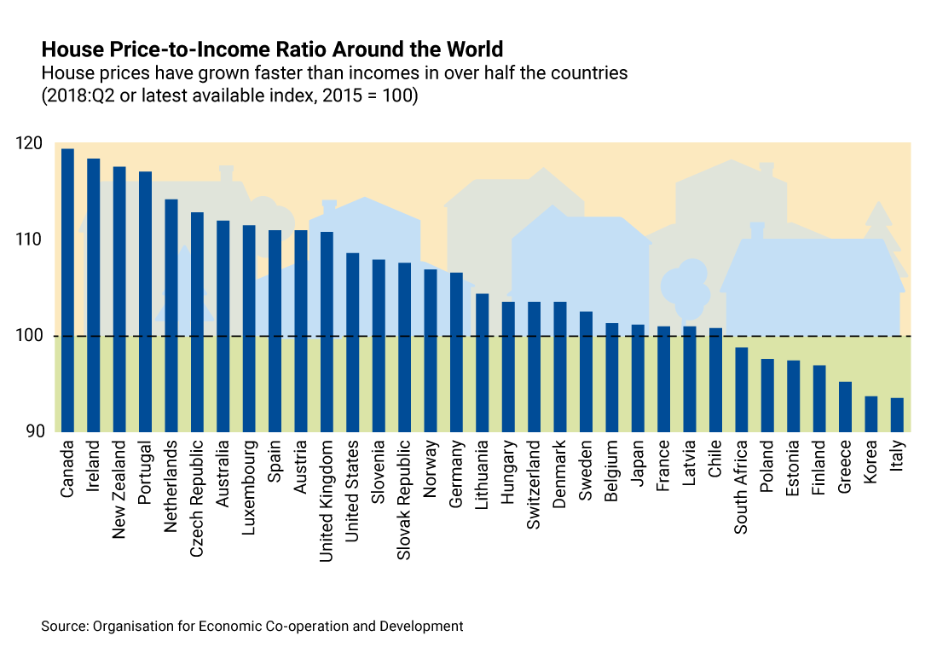

Slide 36
Is it time to worry again?
Pre-Corona Answer: A guarded “no” for five reasons
Lack of synchronicity
Not a synchronized boom across countries
Booms localized to a few cities in many countries
No more ‘benign neglect’
3) Active use of macroprudential policies to tame booms
Not an ‘excessive credit’-driven boom everywhere
4) Prices up, not permits (due to macroprudential policies & supply constraints)
5) Low interest rates driving some of the appreciation

Slide 37
Reason 1: Not a Synchronized Boom
Three -Track Recovery

Slide 38
Differences among the three clusters

Slide 39
Reason 2: In many countries, booms are at city-level
Austria
Netherlands
Canada
United Kingdom

Slide 40


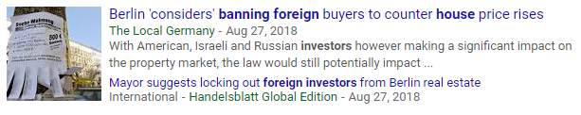

Foreign Investors

Slide 41



Airbnb

Slide 42
REASON 3: active Use of macroprudential policies

Slide 43
REASON 4: prices are up, not permits

Slide 44
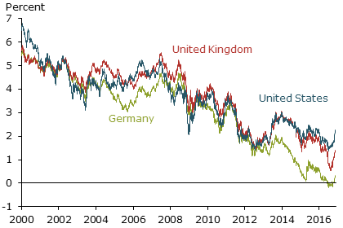
REASON 5: interest rates have been low

