Slide 1
Global Perspectives in Real Estate
Housing Markets around the World
Hites Ahir and Prakash Loungani

Slide 2
House prices over the long-run
Countries included: Australia, Belgium, Canada, Denmark, Finland, France, Germany, Japan, Netherlands, Norway, Sweden, Switzerland, United Kingdom, and United States. Source: Knoll, Schularick, and Steger (2017).

Slide 3
The price of the White House
1800
When Irish architect James Hoban finished the White House in Washington DC in 1800, the value was said to be around US$230 thousand.
2001
Fast-forward 200 years, when George W. Bush took up residence in 2001, it was valued at nearly US$170 million.
2009
when President Bush handed over the keys to Barack Obama in 2009, it was valued nearly US$300 million.
2011
In 2011, with the downturn in the US housing market, the price fell to around US$250 million.
2018
Another fast-forward to 2018 and the value was back up at around US$425 million.
Source: Zillow

Slide 4
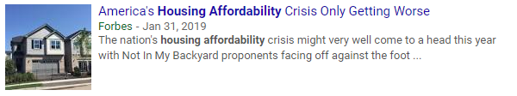


Headlines on affordability

Slide 5



Headlines on short-term rentals and housing

Slide 6
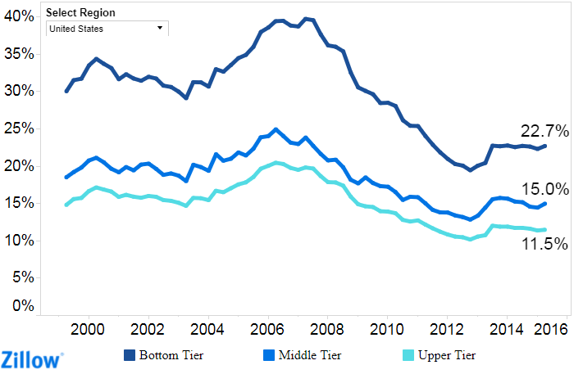
Share of income spent on mortgage

Slide 7
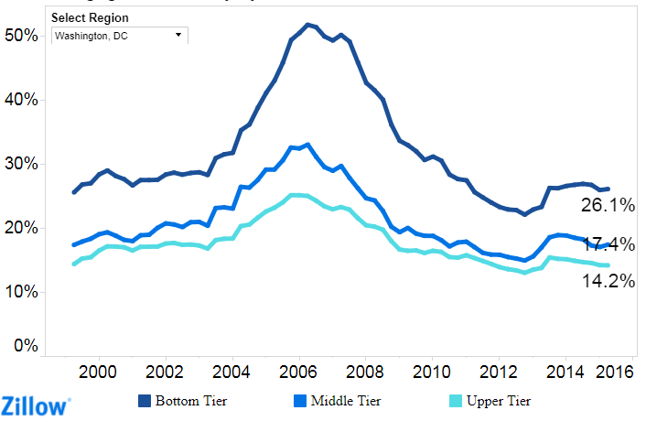
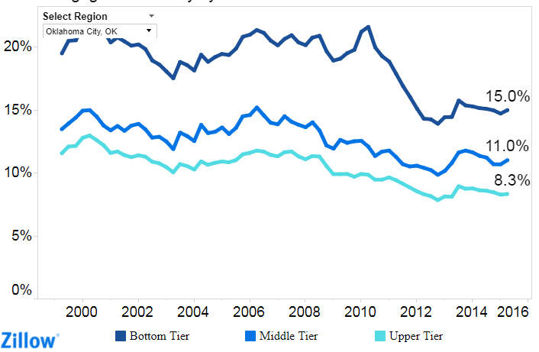
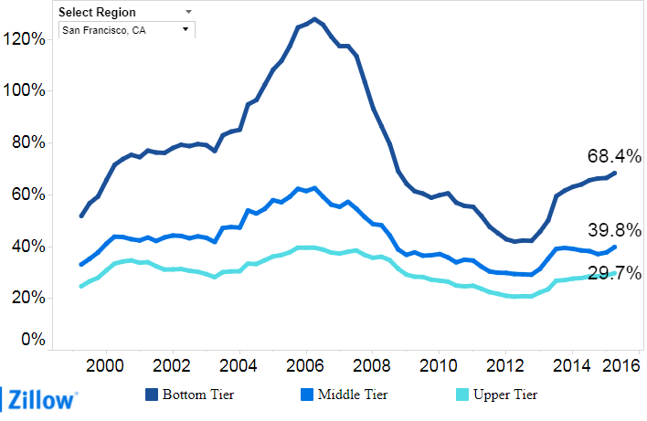
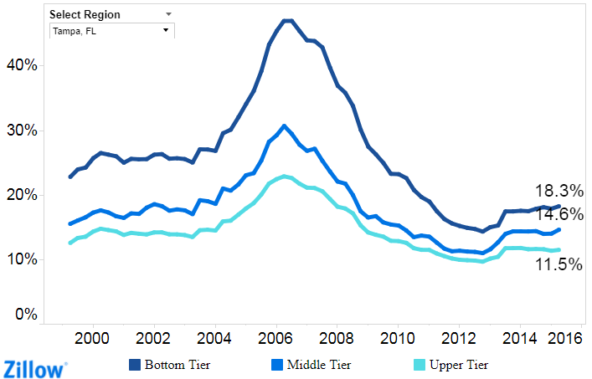
A look at share of income spent on mortgage in select cities

Slide 8
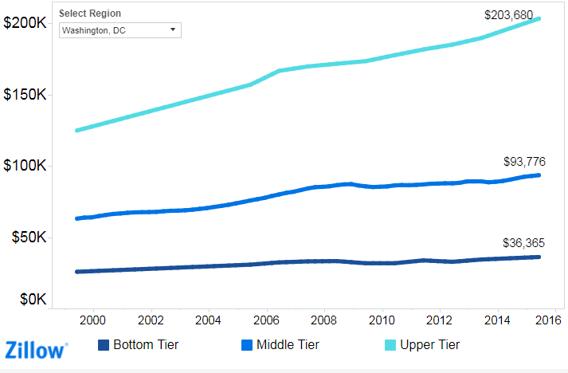
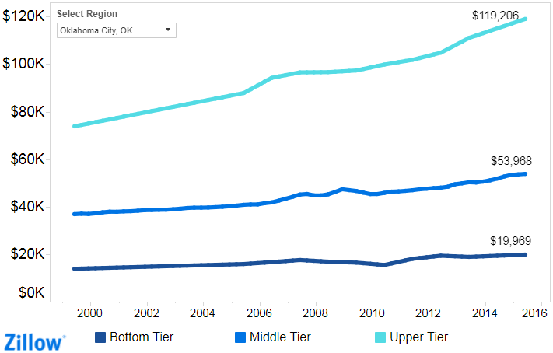
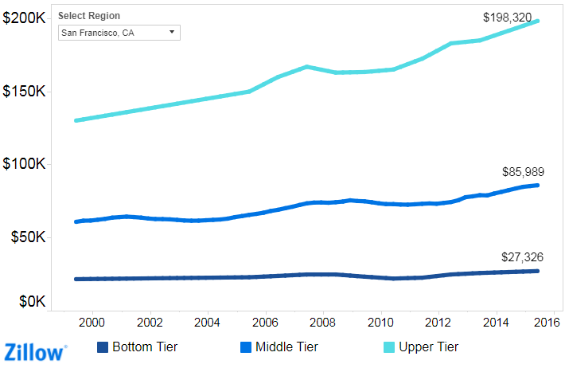
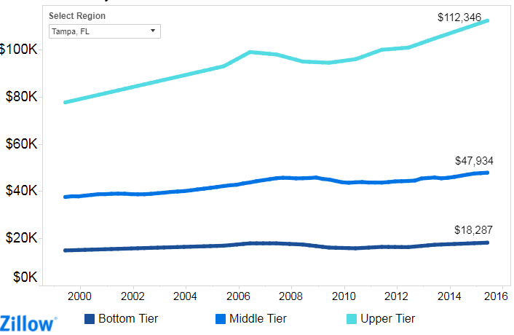
A look at annual income in select cities

Slide 9
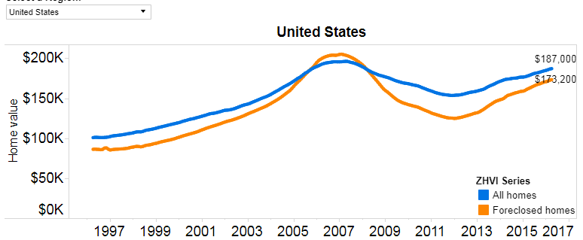
Home values over time

Slide 10
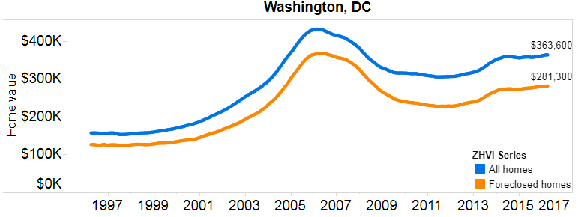
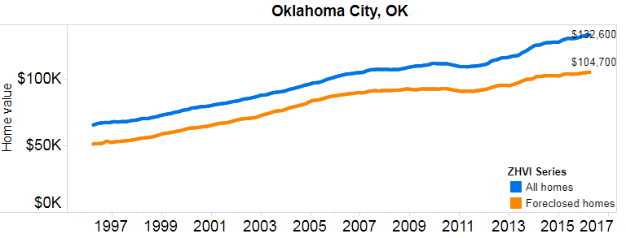
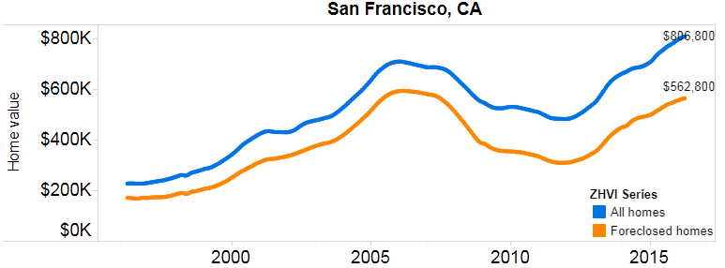
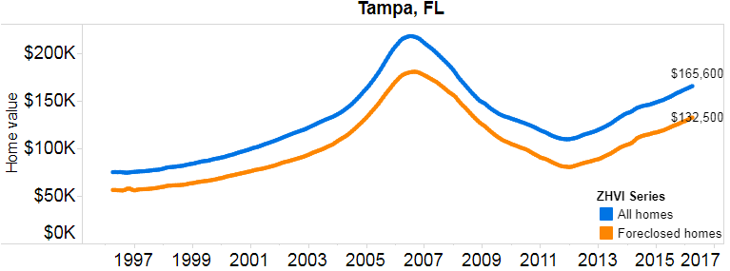
A look at home values in select cities

Slide 11
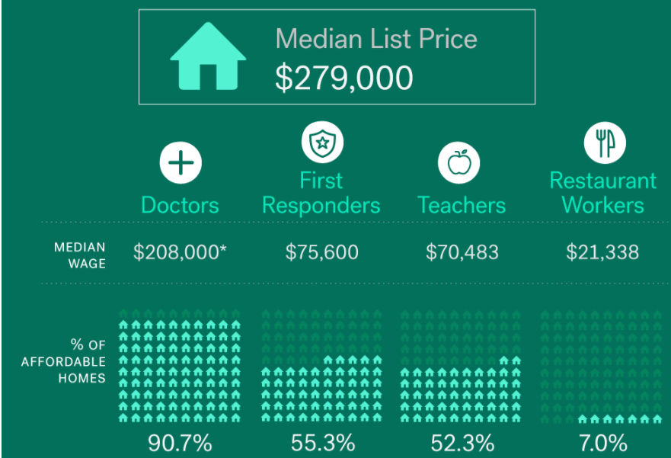
Chicago

Slide 12
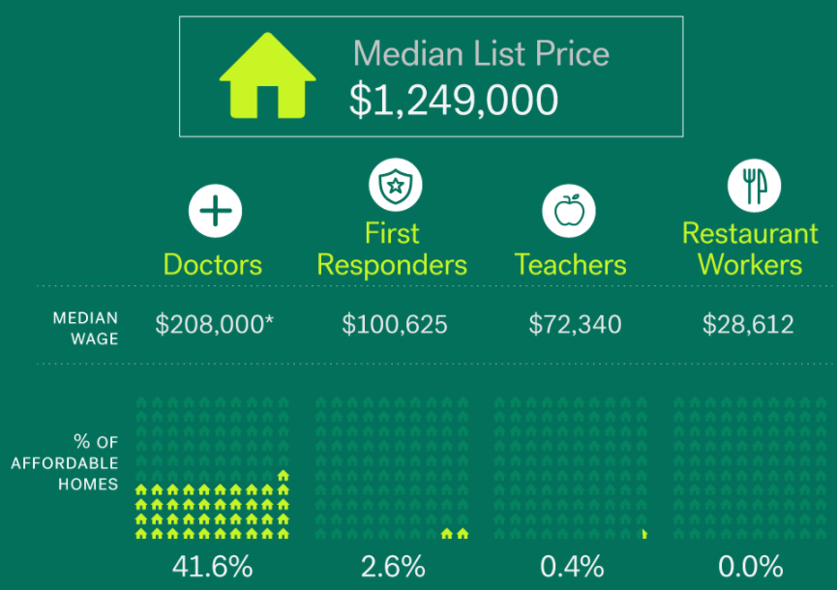
San Francisco

Slide 13
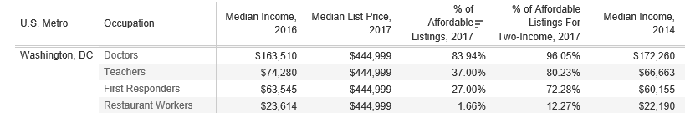

Washington DC area

Slide 14
Data on house prices
Free:
  Cross country data: GHW, OECD, Bank for International Settlements, European Central Bank, Federal Reserve Bank of Dallas, and Numbeo.
  Individual country data: national sources (e.g. central banks)
Based on subscription fee:
  Cross country data: Knight Frank, Global Property Guide

Slide 15
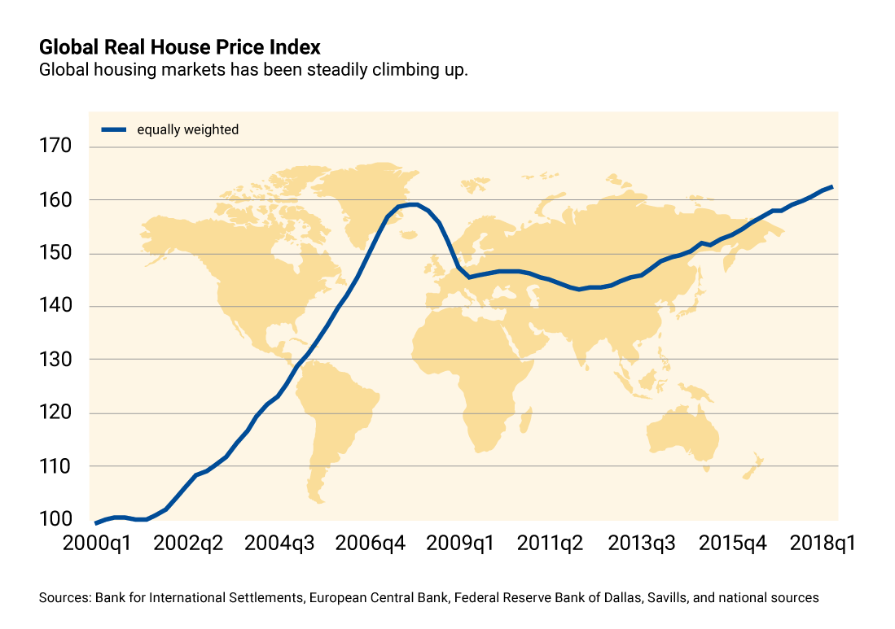
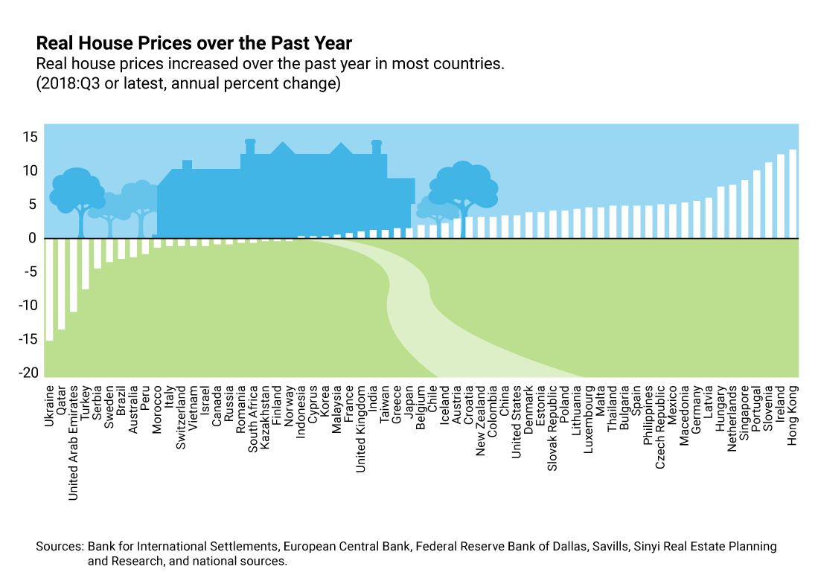
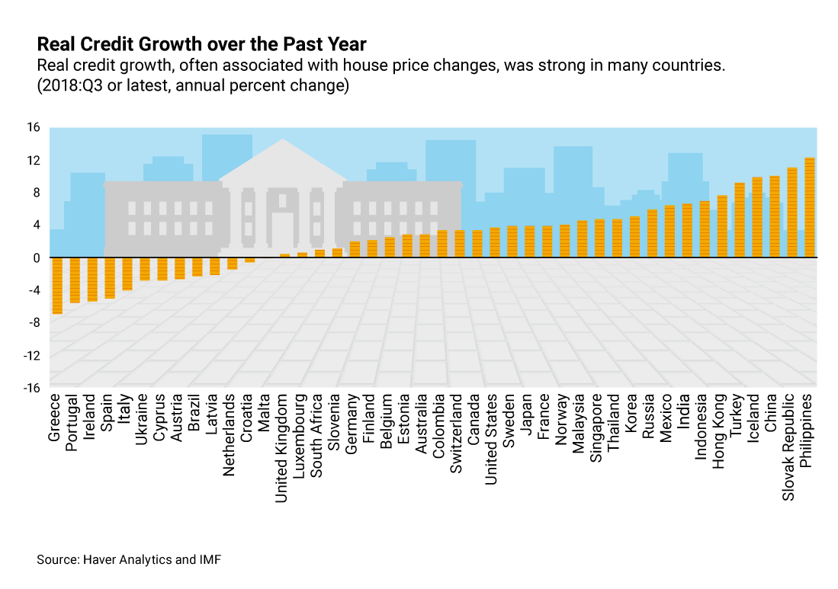
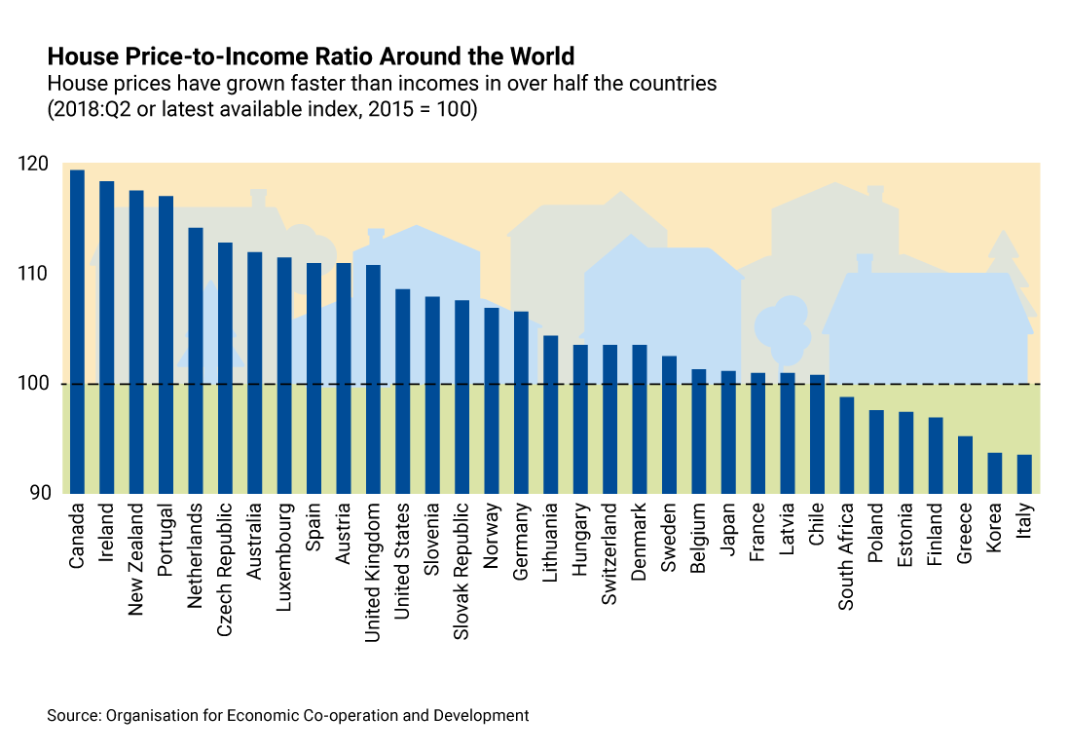
Global Housing Watch

Slide 16
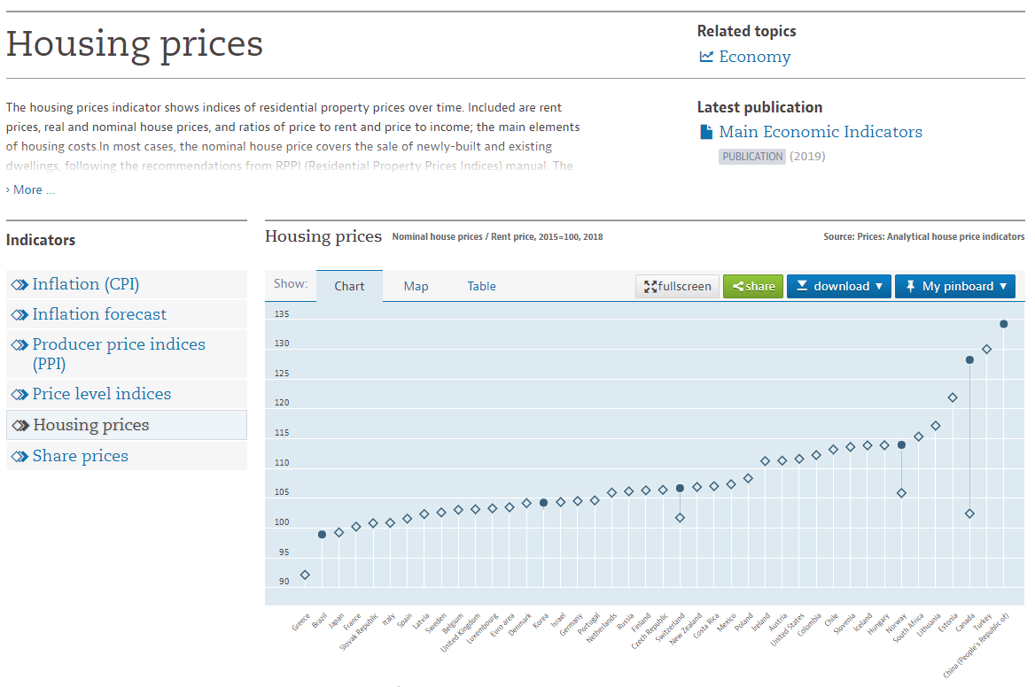
Organisation for Economic Co-operation and Development (OECD)

Slide 17
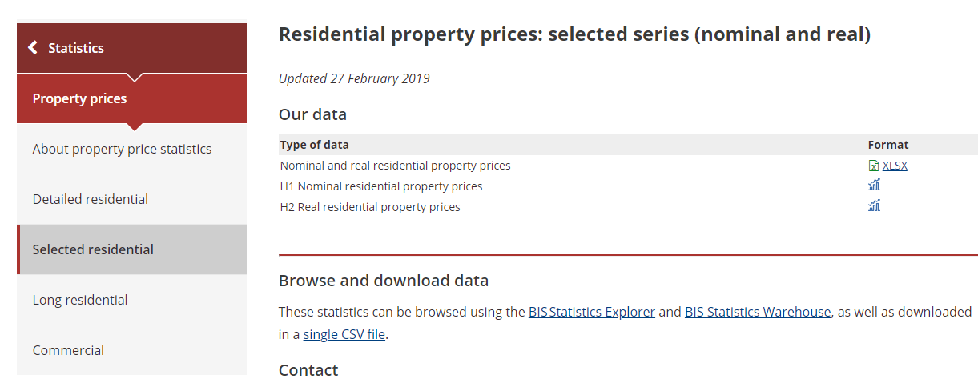
Bank for International Settlements (BIS)

Slide 18
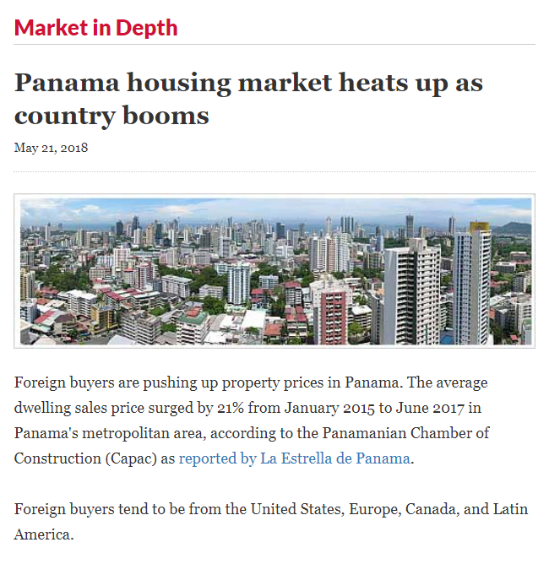
Global Property Guide

Slide 19
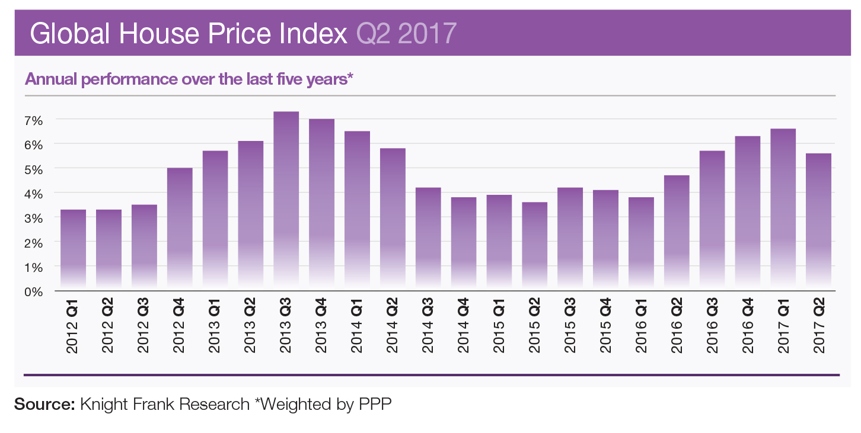
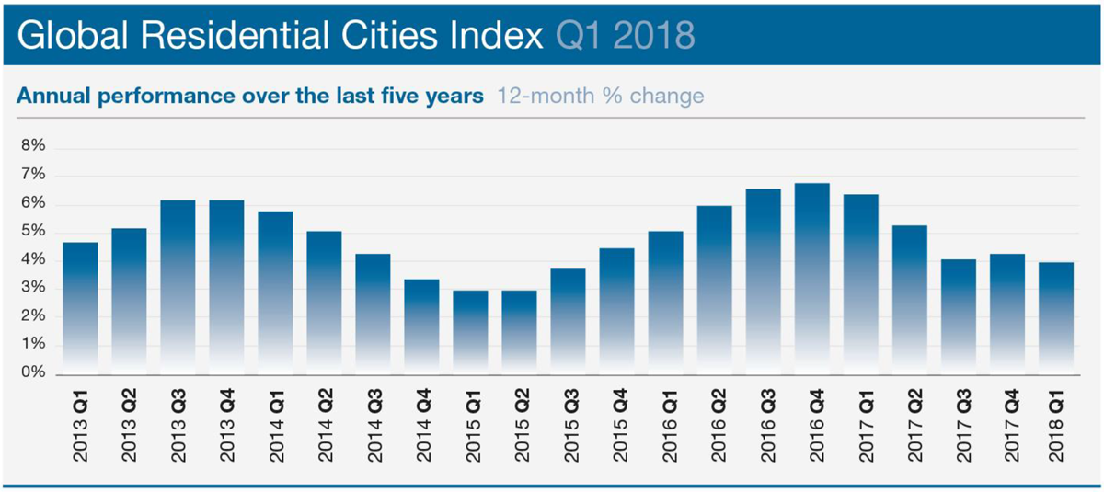
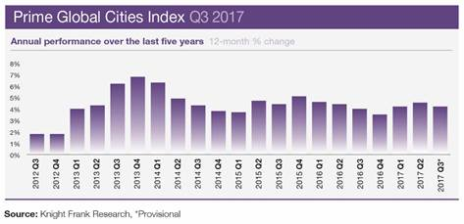
Knight Frank

Slide 20
China’s housing market
Views expressed in this presentation should not be ascribed to the IMF

Slide 21
Outline
Some observations
01
Views from experts on China’s housing market
02
Views from the IMF on China’s housing market
03
Resources on China’s housing market
04

Slide 22
This presentation draws on material from the sources below.
Money & Banking. Residential real estate in China: the delicate balance of supply and demand. April 2015.
Goldman Sachs: Top of Mind (Issue #28) on China Property Market (October 2014)
Y. Deng, J. Gyourko and J. Wu. “Evaluating the Risk of Chinese Housing Markets: What We Know and What We Need to Know”. April 2015.
H. Fang, Q. Gu, W. Xiong and L. Zhou. “Demystifying the Chinese Housing Boom”. April 2015.
B. Ambrose, Y. Deng and J. Wu. “Understanding the Risk of China's Local Government Debts and its Linkage with Property Markets”. January 2015.
M. Chivakul, W. Lam, X. Liu, W. Maliszewski, and A. Schipke. “Understanding Residential Real Estate in China”. April 2015.
The Unassuming Economist: http://unassumingeconomist.com/
And Haver Analytics and The Economist magazine.

Slide 23
Some facts on China’s housing market
1998: Year that China’s residential housing market was privatized
38%: Share of urban housing constructed since 2000 (72% was constructed since 1990)
30%: Minimum down payment for first-time homebuyers and second-time buyers with no outstanding mortgage debt (min. 60-70% for others)

Slide 24
Some more facts on China’s housing market
5 years: Estimated average life of mortgage loans in China, where advance repayment is common (2010 data).
13%: Share of investment home owners who rent out their properties.
20%: Estimated housing vacancy rate in urban areas

Slide 25
Chinese cities are generally grouped into four categories:
Tier I cities include Beijing, Shanghai, Guangzhou, and Shenzhen.
Tier II cities include Beihai, Changchun, Changsha, Chengdu, Chongqing, Dalian, Fuzhou, Guiyang, Haikou, Hangzhou, Harbin, Hefei, Huhhot, Jinan, Kunming, Lanzhou, Nanchang, Nanjing, Nanning, Ningbo, Qingdao, Sanya, Shenyang, Shijiazhuang, Suzhou, Taiyuan, Tianjin, Urumqi, Wenzhou, Wuhan, Wuxi, Xiamen, Xi'an, Yinchuan, and Zhengzhou.
Other small and medium cities are grouped into Tier III or IV cities.

Slide 26
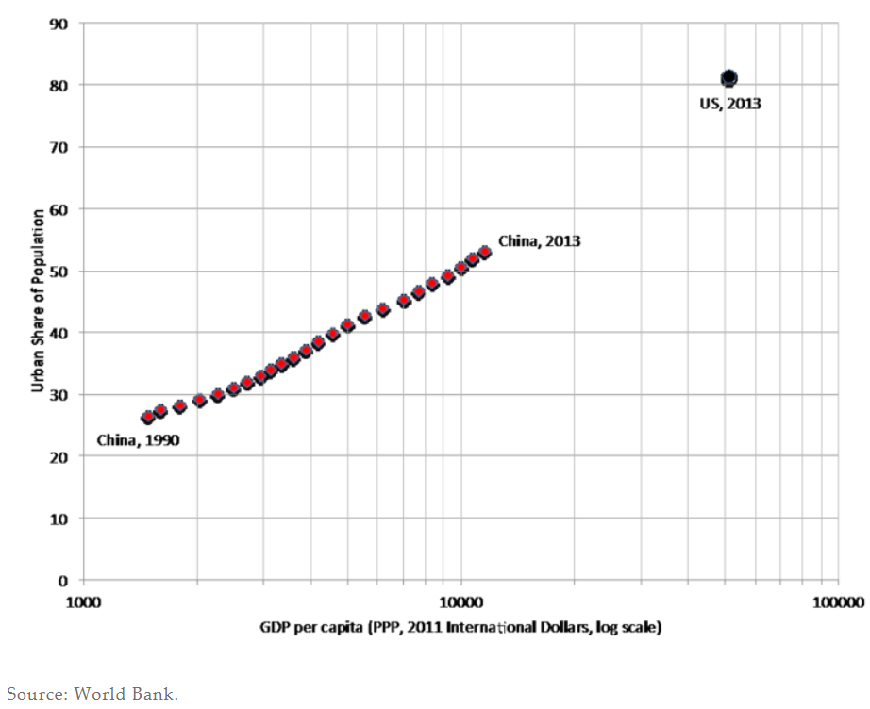
China and the United States: Urbanization rate versus GDP per capita

Slide 27
Urbanization and house prices
“(…) in 1972, only 17% of the 862 million Chinese lived in urban areas and the entire stock of housing was state owned.
Today, more than half of China’s 1.4 billion residents live in cities, while 9 out of 10 households own their homes. Unsurprisingly, this housing revolution has brought with it a property price boom”.

Slide 28
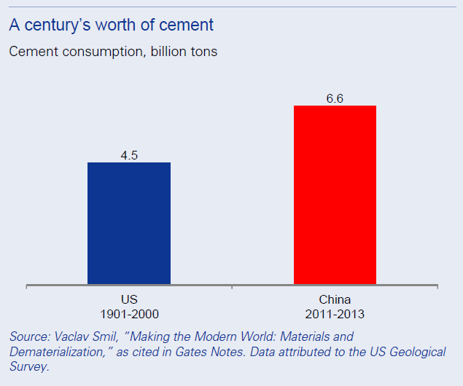
China’s cement market has clearly undergone a very rapid expansion

Slide 29
Outline
Some observations
01
Views from experts on China’s housing market
02
Views from the IMF on China’s housing market
03
Resources on China’s housing market
04

Slide 30
House prices in China

Slide 31
Experts have long been expressing concerns about China’s housing market
2008: “Boom to bust: China’s property bubble is about to burst”
2013: “Haunted housing: Even big developers and state-owned newspapers are beginning to express fears of a property bubble”.
2014: “End of the golden era: China’s property market is cooling off, at long last”.
2015: “Coming down to earth: Chinese growth is losing altitude. Will it be a soft or hard landing?”

Slide 32
A paper on China’s housing market
Y. Deng, J. Gyourko and J. Wu. “Evaluating the Risk of Chinese Housing Markets: What We Know and What We Need to Know”. April 2015.

Slide 33
Substantial heterogeneity across cities
At one end, housing supply has outpaced demand in the interior part of the country. Specifically, housing supply has outpaced demand by at least 30 percent in twelve major markets and by 10 to 29 percent in another eight markets.
On the other end, housing demand has outpaced supply in most major eastern markets. These include: Beijing, Hangzhou, Shanghai, and Shenzhen.

Slide 34
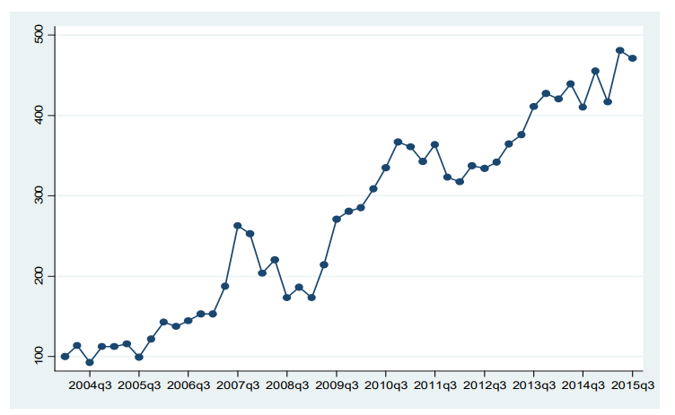
Chinese National Real Land Price Index (35 Markets, Constant Quality Series)

Slide 35
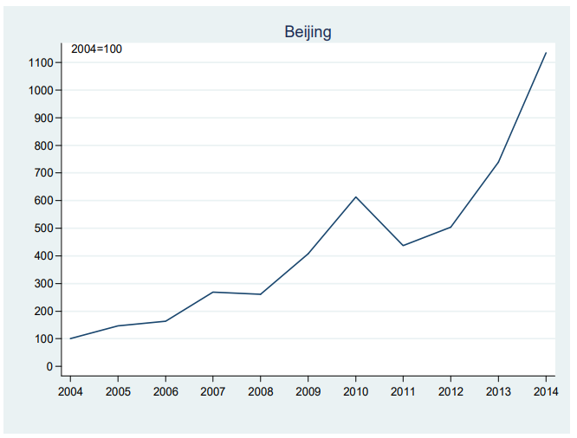
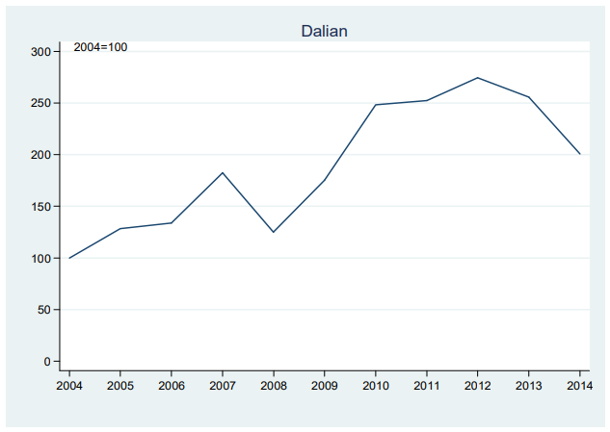
Chinese Regional Real Land Price Index

Slide 36
Another paper on China’s housing market
H. Fang, Q. Gu, W. Xiong, L. Zhou. “Demystifying the Chinese Housing Boom”. April 2015.

Slide 37
Boom accompanied by high income growth and high down payment
This paper constructed a set of house price indices for 120 major cities in China and used a comprehensive data set of mortgage loans from 2003 to 2013.
The paper shows that the Chinese housing boom has been accompanied by strong growth in income, and high mortgage down payments. For a decade, household’s disposable income has had an average annual real growth of 9 percent at the national level. Also, down payments have been over 30 percent on all mortgage loans.

Slide 38
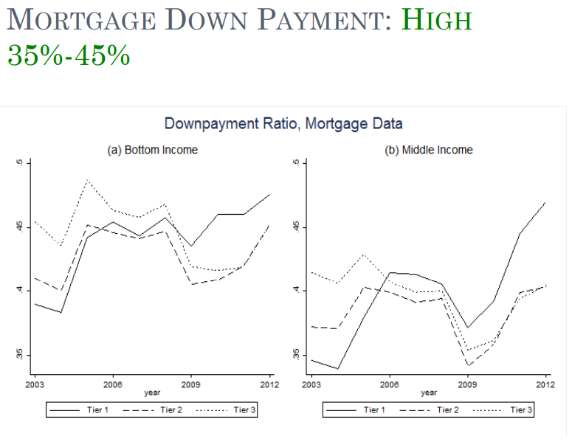
High mortgage down payment

Slide 39
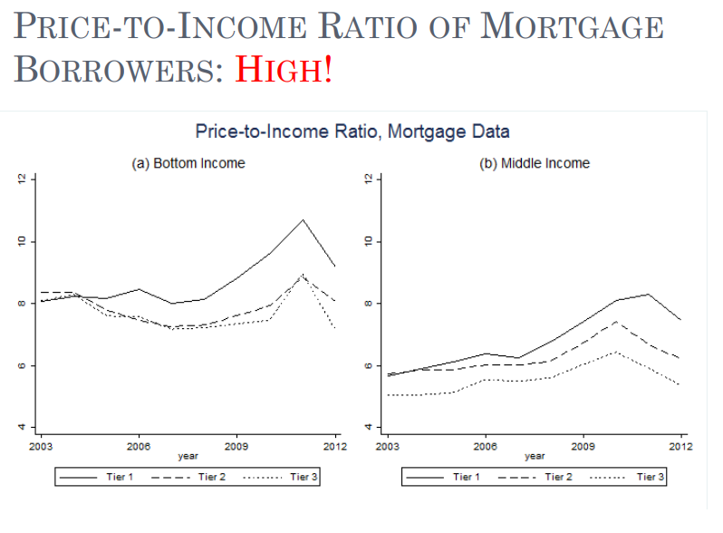
Housing boom has been characterized by high price-to-income ratios

Slide 40
Assessing the risks to China’s housing market: role of expectations
The authors of both papers point out that risks in Chinese housing market could arise with a shift in expectations.
Specifically, the willingness of low-income homebuyers to endure high price-to-income rations is explained by expectation of continued growth in income. However, the high expectation of future income growth may not be sustainable. Likewise, a modest downward shift in expectations could generate sharp decline in house prices

Slide 41
Assessing the risks to China’s housing market: local government debt
A paper by Y. Deng and others notes that unlike local governments in western countries, local Chinese governments are prevented from directly issuing debt to fund mandated capital projects. Therefore, local governments tap into the growing housing market by selling public land to rise funding.
So, future land sales revenue are used to repay the local government’s debt and land parcels are the most widely-used collateral for local government debt. This implies that “a substantial drop in housing or land prices may increase the risk level of local government debt, or even trigger a systematic default”.

Slide 42
Outline
Some observations
01
Views from experts on China’s housing market
02
Views from the IMF on China’s housing market
03
Resources on China’s housing market
04

Slide 43
An IMF paper on China’s housing market
M. Chivakul, W. Lam, X. Liu, W. Maliszewski, and A. Schipke. “Understanding Residential Real Estate in China”. April 2015.

Slide 44
Main point: concerns about overbuilding and its impact on the economy
“Since 2014 the sector has softened visibly, reflecting overbuilding across many cities. (…) The key questions are how severe the adjustment will be and how long it will last. This paper (…) highlights that the adjustment will be a multiyear process with adverse implications for investment and growth. Smaller cities, as well as those in the Northeast region, face more challenging demand-supply dynamics. The key will be to allow the adjustment to take place, while avoiding a too sharp of an economic slowdown.”

Slide 45
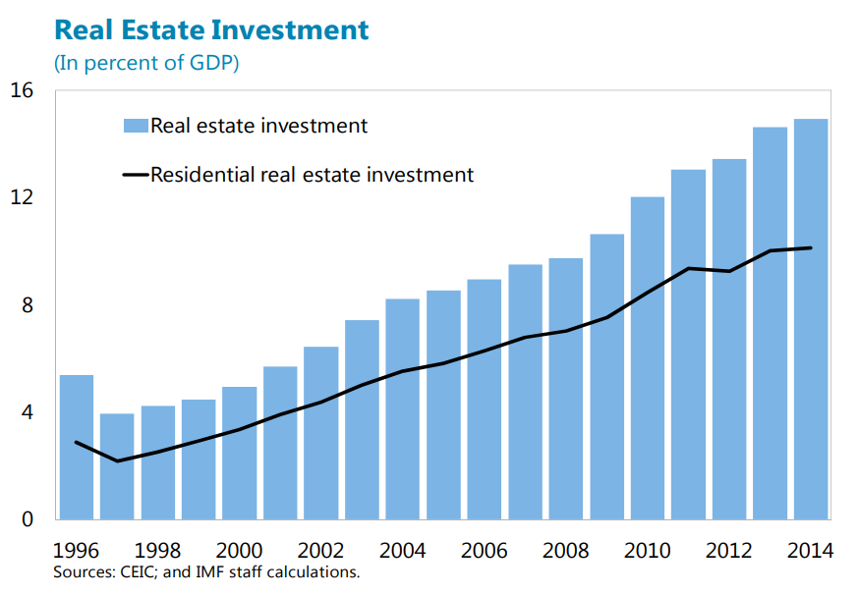
Housing investment in percent of GDP

Slide 46
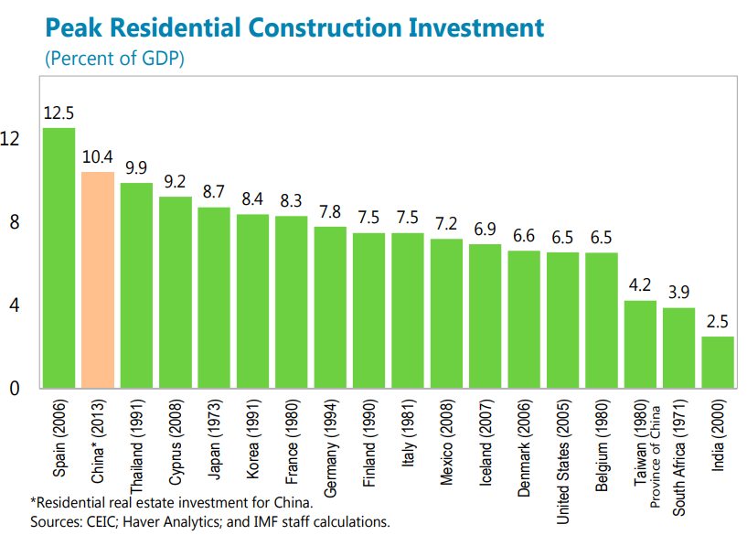
Peak housing investment as percent of GDP

Slide 47
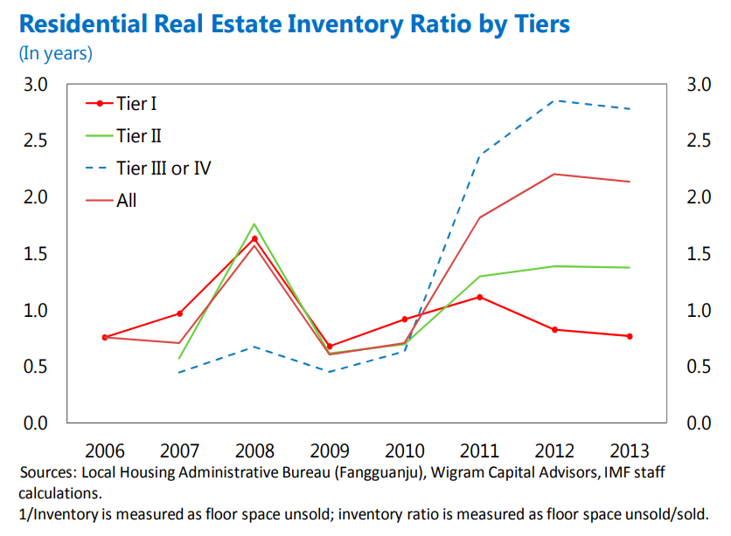
Housing inventory by tiers

Slide 48
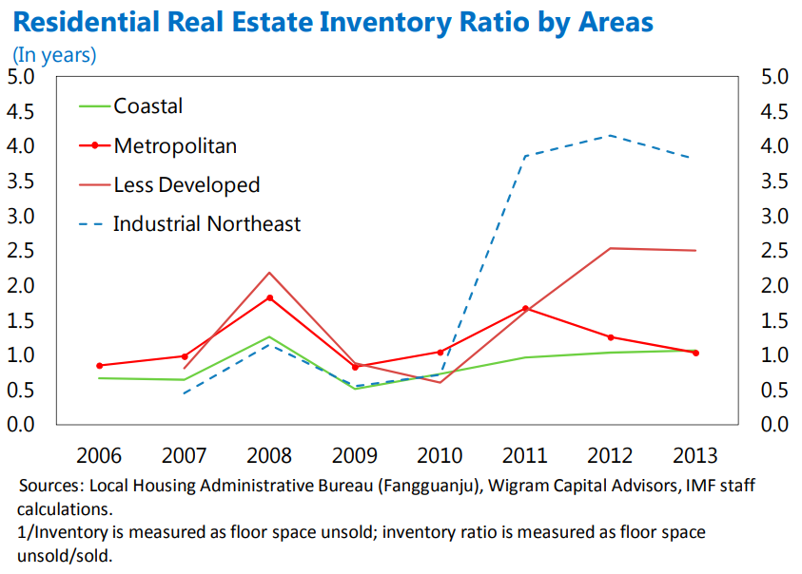
Housing inventory by areas

Slide 49
IMF assessment in 2017
“China’s real estate market rebounded sharply after a temporary slowdown in 2014-2015. The tightening measures since late 2016 seem to have dampened market activity, but house prices and sales remain strong, particularly in smaller cities.”
“Risks are significant on the downside. If house prices rise further beyond “fundamental” levels and the bubble expands to smaller cities, it would increase the likelihood and costs of a sharp correction, which would weaken overall growth, undermine financial stability, reduce local government spending room, and spur capital outflows.”

Slide 50
IMF assessment in 2017
“To stave off such risks, the increasing intensity of macro-prudential and city-specific policies is appropriate, given the diversity in housing conditions, and should continue to be deployed to ensure a smooth adjustment.”
“A longer-term solution to manage better the frequent house price cycles is to introduce recurrent property taxes, resolve land supply constraints in large cities, mitigate local governments’ reliance on land sales, (…)”.

Slide 51
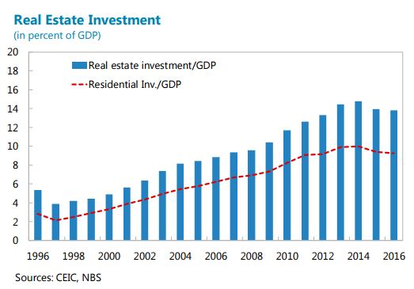
IMF assessment in 2017

Slide 52
IMF assessment in 2018
“Housing inventories in smaller cities declined considerably, due in part to social housing programs. House price growth moderated following the tightening measures since late 2016.”

Slide 53
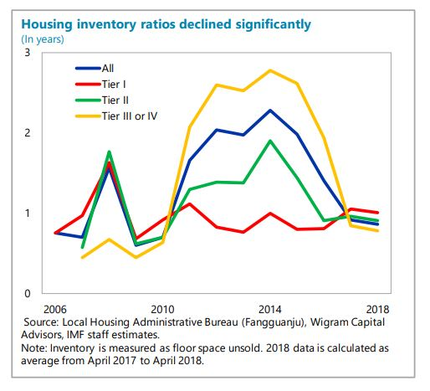
IMF assessment in 2018

Slide 54
IMF assessment in 2018
“A more sustainable housing market. The government’s long-term mechanism for housing appropriately focuses on addressing fundamental supply-demand imbalances. Ensuring long-run sustainability of the housing market requires increasing land supply for residential housing, promoting rental markets, and reducing the reliance of local governments on land sales. De-emphasizing growth targets would allow housing investment to be driven by long-run fundamentals, rather than the need to manage economic cycles. Staff’s projection indicates that residential investment, a key growth engine over the last decade, will decline as a share of GDP over the medium term as household income and consumption growth moderates.”

Slide 55
Outline
Some observations
01
Views from experts on China’s housing market
02
Views from the IMF on China’s housing market
03
Resources on China’s housing market
04

Slide 56
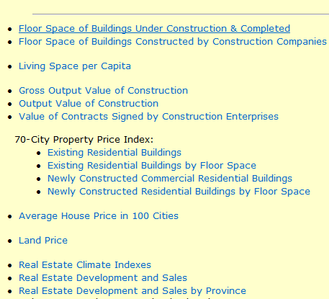
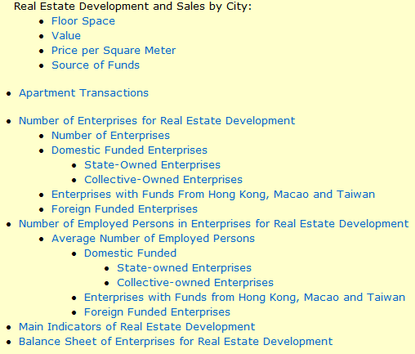
Data from Haver Analytics

