Slide 1
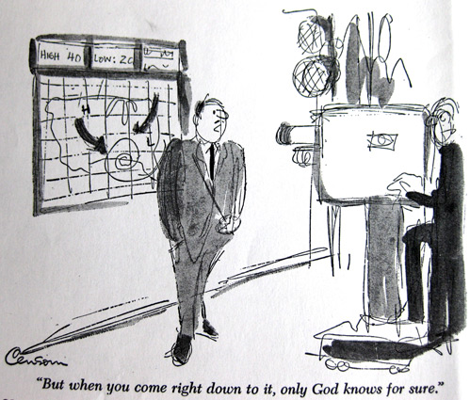
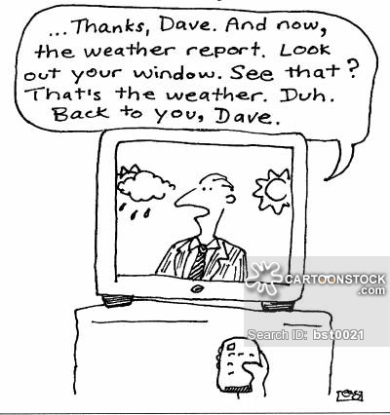
Fail Again? Fail Better?
On the Inability to Forecast Recessions

Slide 2
We didn’t see this recession coming …
3.0
Consensus Forecast
for U.S. Real GDP Growth in 2009
2.0
1.0
0.0
-1.0
-2.0
-3.0
-4.0
Jan-08
Feb-08
Mar-08
Apr-08
May-08
Jun-08
Jul-08
Aug-08
Sep-08
Oct-08
Nov-08
Dec-08
Jan-09
Feb-09
Mar-09

Slide 3
(virtually) no one did …
30
Number of Forecasters
Predicting a U.S. Recession in 2009
25
20
15
10
5
0
Jan-08
Feb-08
Mar-08
Apr-08
May-08
Jun-08
Jul-08
Aug-08
Sep-08
Oct-08
Nov-08
Dec-08
Jan-09
Feb-09
Mar-09

Slide 4
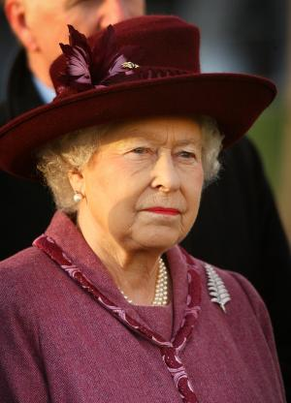
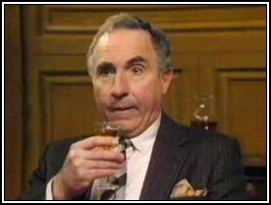
we never see it coming …
“Why did no one see this coming?”
“Ma’am, to see this one coming would have ruined our perfect record of failure to see it coming”

Slide 5
statistical evidence for
“we never see it coming”

Slide 6
New evidence for 2008-12
We study forecasts of output (real GDP growth)
    For 77 countries (incl. 28-country OECD sample)
    From three sources
      Consensus Economics (“private sector forecasts”)
      IMF’s World Economic Outlook (WEO)
      OECD’s Economic Outlook
Evidence shown here on how well recessions were predicted is based on WEO forecasts but results are virtually the same for Consensus and OECD forecasts

Slide 7
Summary of new results
Ability to predict recessions
    Fail Again: Economists were not able to predict too many recessions over this period, particularly in advance. Generally, recessions arrived before they were forecast
    Fail Better: though recessions occurring in 2009 were not predicted a year in advance, the number of recessions was actually over-predicted over the course of 2009. Herman Stekler would argue that this is progress because in the past economists have been too timid about calling recessions.
Statistical photo-finish:
    Consensus, WEO and OECD forecasts are virtually identicalally identical

Slide 8
Year-ahead forecasts:
Comparing Consensus and WEO
Part I:

Slide 9
Current-year Forecasts:
Comparing Consensus and WEO
Part I:

Slide 10
Number of “recessions” in a sample of 77 countries, 2008-12
Part I:

Slide 11
Number of recessions predicted by April of the previous year
Part I:

Slide 12
Number of recessions predicted by September of the previous year
Part I:

Slide 13
Number of recessions predicted by April of the year in which the recession occurred
Part I:

Slide 14
Number of recessions predicted by September of the year of the recession
Part I:

Slide 15
Number of recessions in OECD Sample (28 countries)
Part I:

Slide 16
Number of recessions predicted by June of the previous year
Part I:

Slide 17
Time’s up! Number of recessions predicted by December of the year of the recession
Part I:

Slide 18
Forecasts eventually catch up with reality

Slide 19
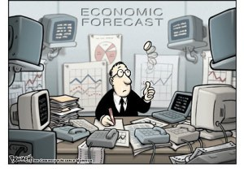
The “coin toss” criticism of these findings
Wouldn’t an ex post assessment of a “coin toss” experiment similarly make forecasters look bad?
Sure, but if real GDP growth is a “coin toss”, why do we invest so much effort in forecasting it?

Slide 20
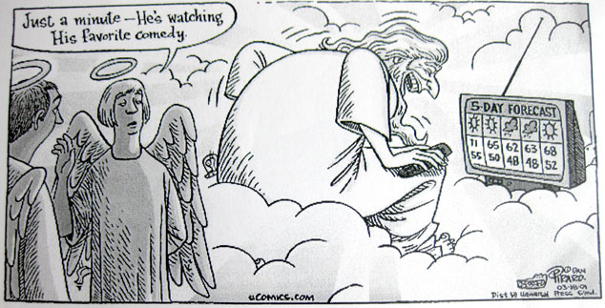
Explanations for failure to predict recessions: Lack of information
Many turning points occur for reasons that are difficult to predict (e.g. geopolitical events or political turmoil)
Macro models are “too linear” to capture outlier events

Slide 21
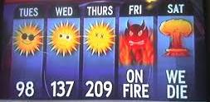
Explanations for failure to predict recessions: Lack of incentives
There are few incentives for producing an "outlier" GDP forecast. Reputational loss from incorrectly calling a recession may exceed benefits from correctly calling one.

Slide 22
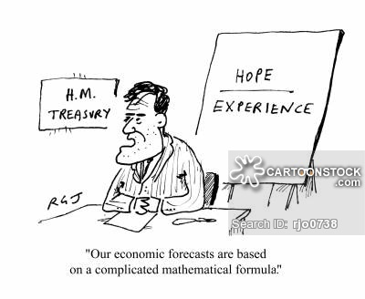
Explanations for failure to predict recessions: Behavioral reasons
Emphasized by Nordhaus (1987): as forecasters, we tend to break the “bad news to ourselves slowly, taking too long to allow surprises to be incorporated into our forecasts.”

Slide 23
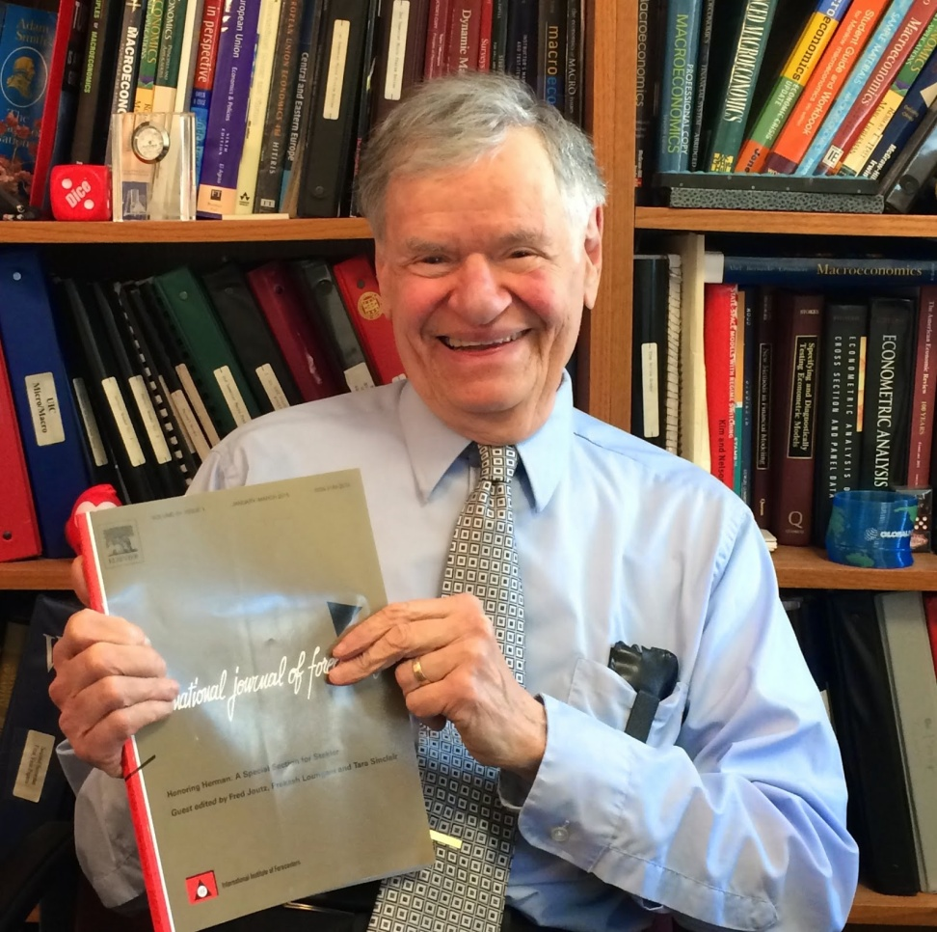
How to get forecasters to do better:
Give a ‘Stekler Award’ for Courage in Forecasting
“I personally believe that the cost of a recession is so great that a forecaster should never miss one.
Some people argue that turning points are unpredictable. I disagree.
I have never had trouble predicting recessions. In fact, I have predicted n+x of the last n recessions.’’
Stekler (2010 interview)

Slide 24
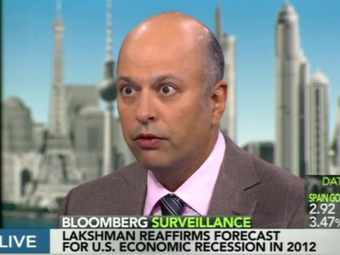
Winner of First ‘Stekler Award’:
Lakshman Achuthan (Economic Cycle Research Institute)
“On September 21, 2011, ECRI notified clients that the U.S. economy is indeed tipping into a new recession. And there's nothing that policy makers can do to head it off…”
“our September 2011 U.S. recession forecast did turn out to be a false alarm.”
“the 2012-13 cyclical downturn turned out to be the worst “non-recession” in half a century rather than a full-blown recession”
“key to avoiding recession in 2012 was the fortuitous plunge in oil price volatility”

