Slide 1
New growth model’S
Sriram Balasubramanian
Economist and authoR

Slide 2
CONTENTS PAGE
INTRODUCTION
HISTORY OF THE WORLD THROUGH GDP
EXAMPLES OF UNIQUE GROWTH CHARACTERISTICS (JAPAN and INDIA)
BHUTAN’s GNH
EASTERLINS PARADOX
OBSERVATIONS FROM OUR IMF PAPER
THE WAY FORWAR
CONCLUSION

Slide 3
QUOTES
introduction
Economic policymaking has been consumed in the last century by a single point agenda---to grow more, earn more income and create a prosperous society.
Trends and cycles in Income and Sustained Growth in your syllabus would have covered these paradigms.
Focus on ‘one size fit-all policy’ in the 19th century and too much focus on one macroeconomic indicator---GDP---has had its shortcomings.
Societies have started to look for more sustainable solutions which encompass happiness, satisfaction, health among others.
Thus the need for more diverse growth models
“We must focus specifically on living standards and human, social and natural capital when we set targets and track progress. In our next budget, we will set five priorities each deliberately focused on long-term intergenerational change” New Zealand PM Jacinda Arden
“Happiness Matters in todays world” Former Bhutanese PM Tshering Tobgay
““The purpose of studying economics is not to acquire a set of ready-made answers to economic questions, but to learn how to avoid being deceived by economists” Joan Robinson

Slide 4
HISTORY OF THE WORLD through gdp
Western nations have been at the forefront of global growth in the last two centuries.
Quantum of development and growth have surged especially in the last few decades.
Industrial revolution was one of the key catalysts to drive this growth in the last few centuries.
In the advent of the digital age, systems have evolved and new mechanisms have come into place.
While these are common factoid, question really is how was the ancient world’s economic landscape?
Source: ‘The World Economy--- A Millennial Perspective’, Angus Madison, 2001

Slide 5
ECONOMIC HISTORY OF THE WORLD THROUGH GDP
India had the largest GDP with 33,750 USD million in 0 A.D/CE according to Angus Madison's path-breaking research work.
The country had a linear growth trajectory from year 0 AD/CE to 1700, reinforcing its global economic dominance over 1700 years minimum.
India and China alternated between each other during these years as the top economy in the world.
United States was barely existent, Western Europe less than 1/3 of India and China in GDP.
Source: ‘The World Economy--- A Millennial Perspective’, Angus Madison, 2001

Slide 6
Japan’S UNIQUE FEATURES
One of the highest savings ratios in the world at approximately 27 percent in 2018.
Despite very low interest rates, Japanese were not willing to spend since they are used to a socio-cultural framework of saving enough before spending.
Led to the Bank of Japan (BOJ) to make interest rates negative to boost spending, yet Japanese kept their money in the Banks!
Abenomics largely focusses on stimulating growth within the natural characteristics of the Japanese economy.
“Japan’s public pension investment fund is now the largest single global investor in U.S. equities; that SoftBank manages the world’s leading global technology investment fund; that Japan has surpassed China to become the largest international investor in Australia; that Japan’s mega-banks have been the dominant creditor in non-China Asia for three years running; that Japanese companies are on target for another record year of outward foreign direct investment, to name just a few of the big headline deals that have channeled Japan’s domestic surplus savings into the world” (Japantimes, 2018)

Slide 7
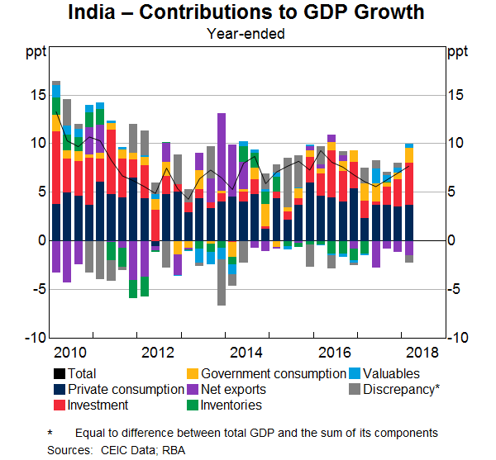
India’S unique features
More than 70 percent of the country’s economy is based in the informal sector. Almost 82.4 percent of the jobs are in the informal sector. ( NSSO, Hans India, 2017)
Large sections of this informal sector work through networks of ‘trust’, ‘family’ or ‘communities’ across societies.
The informal sector also implies that structured benefits/protections in the corporate sector do not reach the concerned people.
Most of them are small and medium sized firms---scalability is a challenge although it helps to buffer the economy from the negative impacts of the global economy.
Culture plays an important role in economic transactions---measuring it is a big challenge.
India’s savings ratio is quite robust at above 30 percent on an average over the last decade.

Slide 8
characteristics
BHUTAN’S gnh
In a new IMF working paper, my co-author and I explore Bhutan’s gross national happiness (GNH) index and its impact on macro-indicators (Balasubramanian and Cashin 2019). The paper investigates the correlation and causality operating between GNH and GDP, the relevance of the Easterlin Paradox, and the broader lessons that countries can learn from this exercise.
Traditionally Buddhist country
Population of about 750,000
Transitioned from absolute to constitutional monarchy in 2008
Lower middle income country which reduced extreme poverty at rapid pace.
GNH:
GNH forms the core of Bhutanese economic policy making.
More than 50 indicators construe GNH using the 4 Pillars and 9 Domains mentioned here.
Serves as the base for policy making, not GDP or other income related measures.
Aligned to Bhutan’s socio-economic values and their broader vision of governance among others.
Source: IMF Working Paper, Balasubramanian Sriram, Paul Cashin and Columbia University (2016)

Slide 9
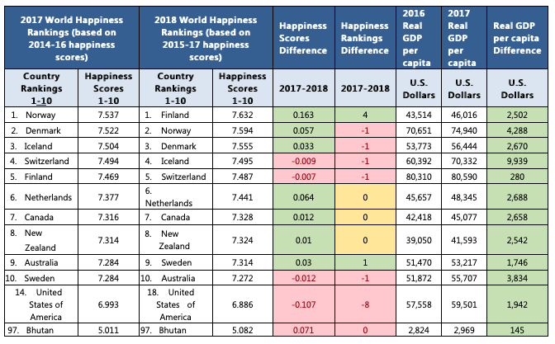
EASTERLIN’s PARADOX
In a famous article, Easterlin (1974, revised 1995) asked whether “raising the incomes of all will raise the happiness of all?”. This question was raised following the observation that reported happiness levels remained flat over the long-run in countries which had experienced high rates of real income growth.
This anomaly was subsequently dubbed the Easterlin Paradox. How relevant is this in todays times is a valid point.
USA has been having an increase in per capita income for the last 20 years yet its happiness/satisfaction indices have had diminishing returns/stagnated as it grows.
Countries such as as Iceland, Switzerland, and Australia seem to be in line with the Easterlin Paradox
Source: ‘Heliwell (2011), IMF Working Paper, ‘Macroeconomic Indicators and Kingdom of Bhutan’ (Balasubramanian Sriram, Paul Cashin, 2019)

Slide 10
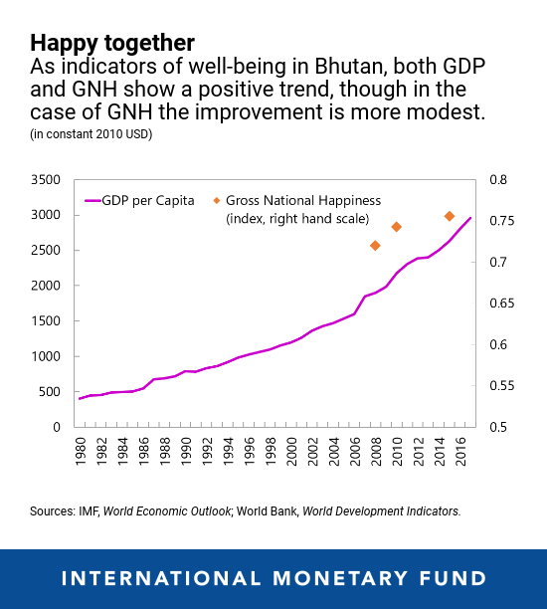
OUR OBSERVATIONS IN THE PAPER
Easterlin’s paradox is applicable to a few countries in the top 10 happiness driven countries---i.e higher incomes don’t necessarily mean that the country is satisfied.
Bhutan also seems to be falling in this category as you see the GNH index plateauing, more surveys and results are needed.
Definite gap between inputs and outcomes
Ways and means needs to be explored to integrate this into mainstream policymaking.
Source: IMF Blog ‘Don’t Worry, Be Happy’, Balasubramanian Sriram, Paul Cashin

Slide 11
THE WAY FORWARD
A wellness budget, similar to the New Zealand PM’s proposal, which is underpinned by a scientifically-driven system that measures wellness indicators similar to GNH, which is used to drive policy.
A happiness index in each ministry within government as an overriding tool for policymaking. In essence, this could serve as a necessary yet non-intrusive tool to ensure that policies in individual ministries are in line with the broader happiness parameters of the country.
A bottom-up approach presents a third option, where a huge awareness drive is created among people of the need for happiness policies. An example that comes to mind is India’s Swaach Bharat initiative to promote cleanliness and sanitation across the country on a large scale. This initiative resulted in rural sanitation increasing to almost 90% (Government of India 2019) in 2018 compared to 35% in 2014.

Slide 12
acknowledgments
Professor Prakash Loungani for this opportunity
My co-author Dr Paul Cashin (IMF Assistant Director) for persevering with this idea and pursuing it through the paper.
Columbia University Capstone Team and Staff
Various Sources
Your patience!

Slide 13
THANKS!
Q AND a sESSION

