Slide 1
SIS 628 Feb. 6, 2019
Inequality and Sustained Growth

Slide 2
DISTRIBUTION OF INCOME (INEQUALITY)

Slide 3
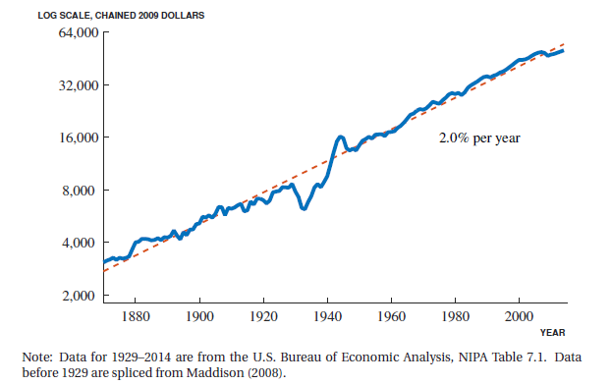
U.S. real income per person (a.k.a. US real GDP per capita)

Slide 4
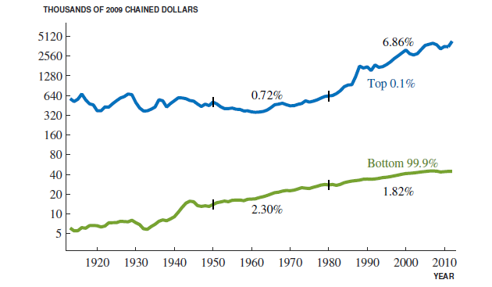

Slide 5
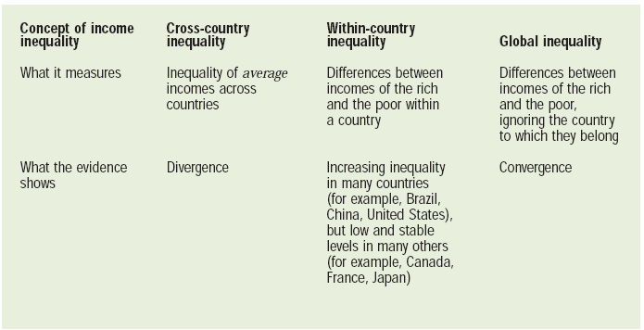
Basic Facts About Income Inequality

Slide 6
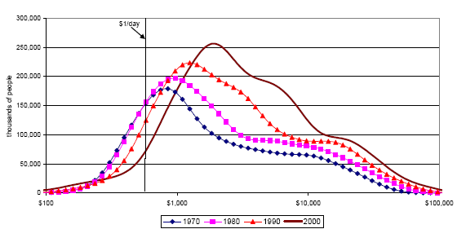
‘Global Inequality’ (“Imagine there’s no countries”: Evolution of the World Distribution of Income

Slide 7
Inequality: measures and drivers

Slide 8
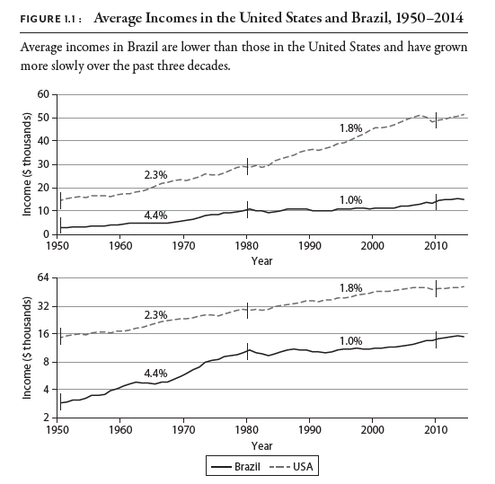

Slide 9
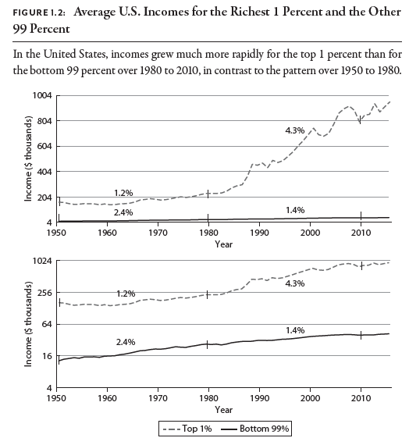

Slide 10
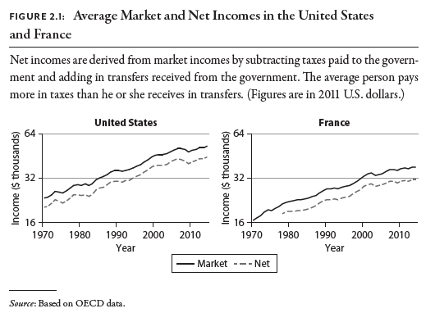

Slide 11
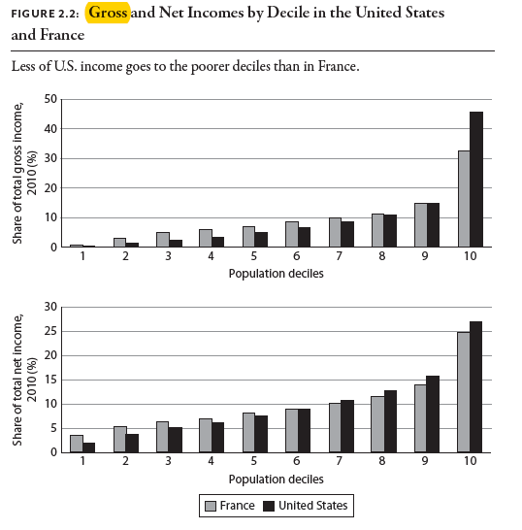

Slide 12
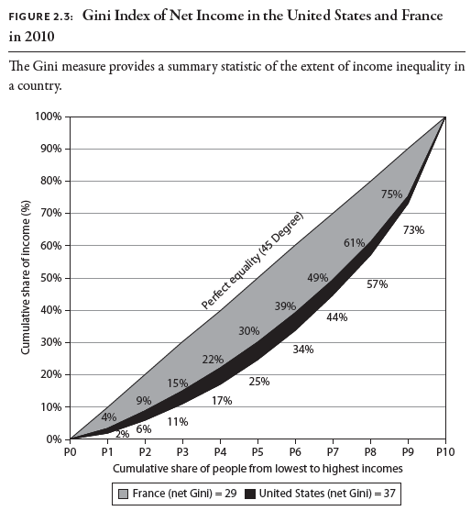

Slide 13
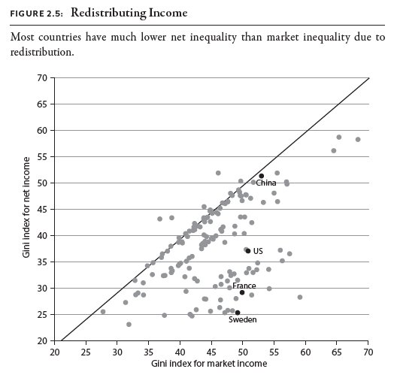

Slide 14
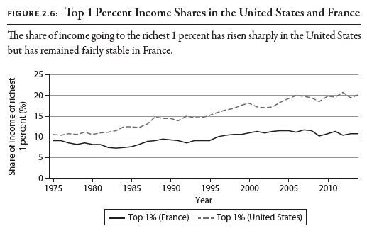

Slide 15
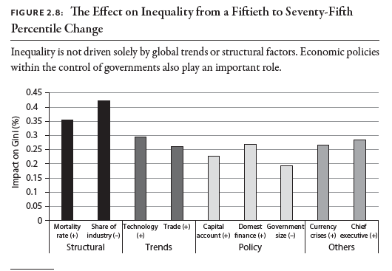

Slide 16
Inequality and sustained growth

Slide 17
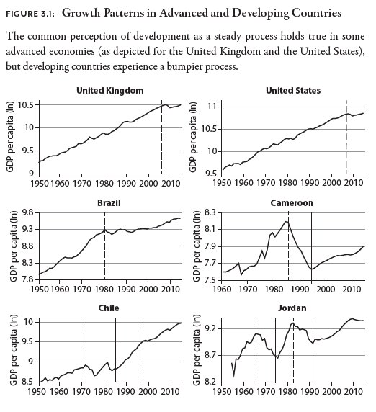

Slide 18
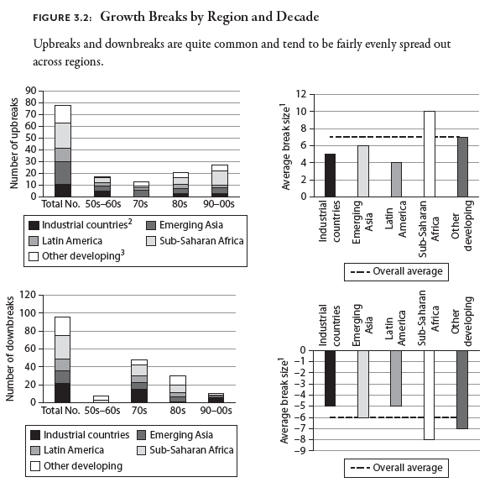

Slide 19
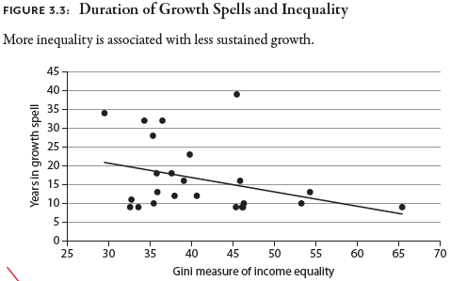

Slide 20
