Slide 1

Housing Markets: Setting the Scene
Prakash Loungani
International Monetary Fund
Presentation at
European Commission
November 30, 2016
VIEWS EXPRESSED ARE THOSE OF THE PRESENTER
AND SHOULD NOT BE ASCRIBED TO THE IMF.

Slide 2
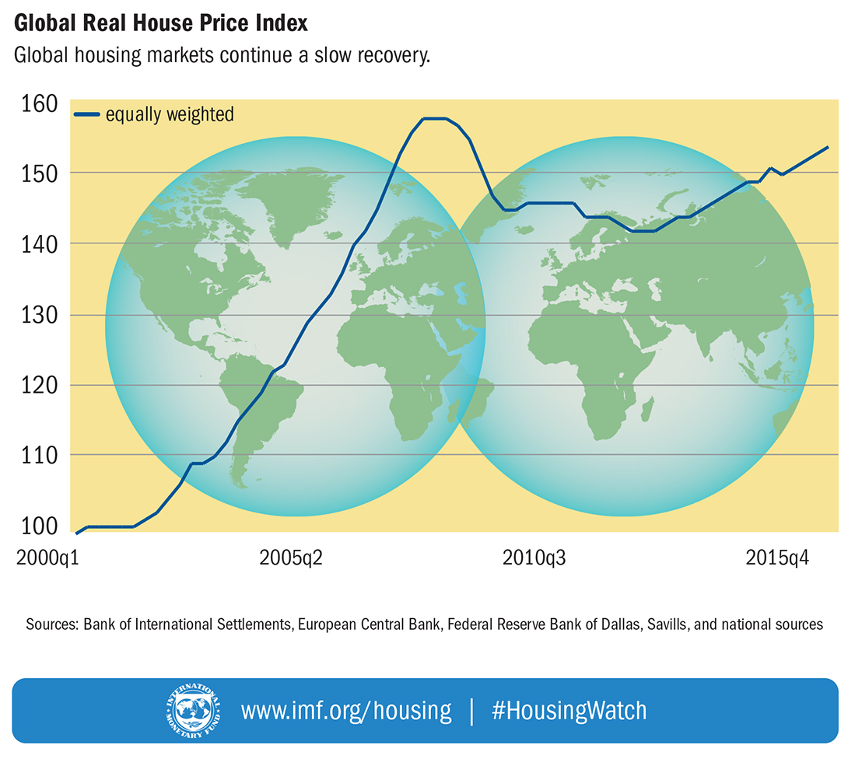
Global House Price Index:
Almost back to pre-crisis level

Slide 3
Time to worry again?
Answer: A guarded “no” for five reasons
Lack of synchronicity
Not a synchronized global boom across countries
Booms localized to a few cities in many countries
Not an ‘excessive credit’-driven boom
Some booms due to supply constraints
Low interest rates driving some of the appreciation
No more ‘benign neglect’
5) Active use of macroprudential policies to tame booms

Slide 4
Not a synchronized boom

Slide 5
Three-track recovery

Slide 6
Countries in each cluster
Gloom
Brazil, China, Croatia, Cyprus, Finland, France, Greece, Italy, Macedonia, Morocco, Netherlands, Poland, Russia, Serbia, Singapore, Slovenia, Spain, and Ukraine.
Bust and Boom
Bulgaria, Denmark, Estonia, Germany, Hungary, Iceland, Indonesia, Ireland, Japan, Latvia, Lithuania, Malta, New Zealand, Portugal, South Africa, Thailand, United Kingdom, and United States.
Boom
Australia, Austria, Belgium, Canada, Chile, Colombia, Czech Republic, Hong Kong SAR, India, Israel, Kazakhstan, Korea, Malaysia, Mexico, Norway, Peru, Philippines, Slovak Republic, Sweden, Switzerland, and Taiwan POC.

Slide 7
Incidence of financial crisis

Slide 8
Booms localized to a few cities in many cases

Slide 9
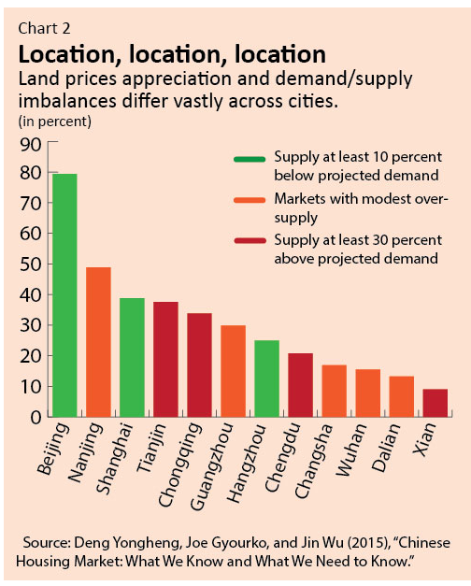
China: boom or gloom?

Slide 10
Booms in other cities

Slide 11
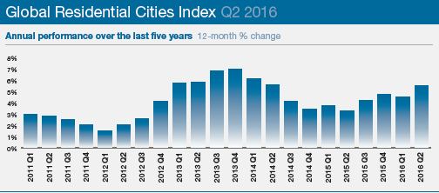
Knight Frank’s Cities Index

Slide 12
Knight Frank’s top cities

Slide 13
RICS Commercial Property Monitor for Cities

Slide 14
Some booms due to supply constraints

Slide 15
Housing permits in each cluster

Slide 16
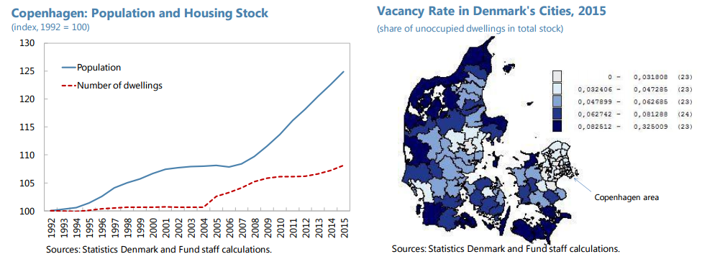
IMF references to supply constraints:
Denmark
(billions of Australian dollars)
“Supply conditions matter for house price developments. The analysis (…) highlights the often-underestimated role of housing supply constraints in shaping local house prices in Danish cities. Cities such as Copenhagen where the stock of housing is relatively inflexible and responds slowly to changes in housing demand could see higher price growth (…).”

Slide 17
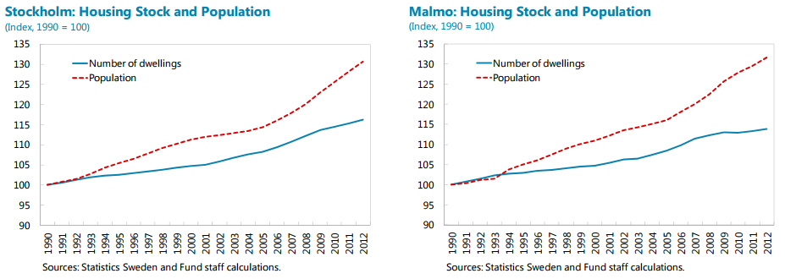
IMF references to supply constraints:
Sweden
“House price booms in Sweden, as in many other countries, are a big city phenomenon (…) Differences in housing supply conditions across cities contribute to such price divergences. Immigration inflows, rapid urbanization, and income growth have put pressures on the demand for housing in large cities. But the housing stock has also not expanded at a pace commensurate with that demand. ”

Slide 18
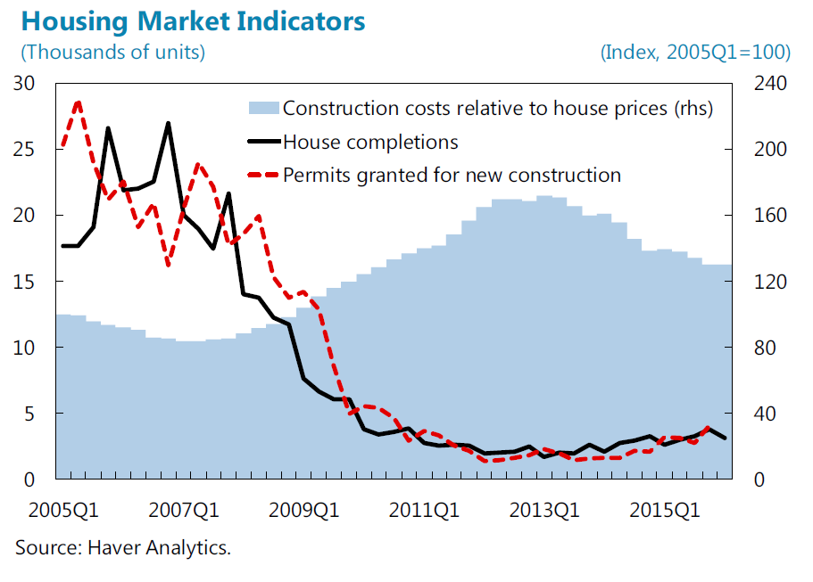
IMF references to supply constraints:
Ireland
“Boosting the housing supply would help mitigate property price and rent pressures. The sluggish construction activity in recent years reflects the sector’s downsizing after the bursting of the property market bubble in 2008-09 and the ensuing limited access to finance for companies. High construction costs due to strict planning requirements have also been a factor.”

Slide 19
IMF references to supply constraints: Australia, Canada, France
Australia: Housing supply does seem to have grown significantly slower than demand, reducing (but not eliminating) concerns about overvaluation.
Canada: Montreal and Ottawa registered near zero [house price] growth over the last four quarters. Home sales have not been particularly strong suggesting that price increases may be due to supply constraints rather than demand factors.
France: “More could be done to alleviate structural rigidities in the housing market. Residential construction has fallen by 14 percent, and real house prices by 11 percent, since the peak in 2007. While this decline is partly cyclical, a succession of laws introducing regulatory and tax changes may also have contributed.” (July 2015)
Notes:
Selected Issues (October 2015): http://www.imf.org/external/pubs/ft/scr/2015/cr15275.pdf

Slide 20
IMF references to supply constraints:
Germany, Netherlands, Norway
Germany: The strength of markets in the center of the largest cities, where supply restrictions are the tightest, also points to an important role of housing supply factors.” (July 2014)
Netherlands: “Zoning regulations have constrained supply and contribute to its low price elasticity. In addition, tight zoning and other regulations have held back new developments.” (December 2014)
Norway: “[IMF] staff would welcome new measures that could take some of the pressure off of housing prices by relaxing unneeded supply restrictions.”

Slide 21
IMF references to supply constraints:
United Kingdom
House prices: “House price increases in the UK stand out among the OECD economies. Over the past 30 years, real house prices have increased the most in the UK when compared with other OECD economies. Indeed, over this period, annual house price increases have averaged 3 percent in real terms, compared with 1 percent for the OECD as a whole.” (July 2014)
Housing construction: “(…) rapid price increases reflect the impact of serious supply constraints … Residential investment in the UK as a share of GDP is among the lowest across the OECD economies. The sluggish response of residential investment to a strong demand for housing is attributed to supply-side constraints … restrictive planning regulations, in combination with inadequate incentives for local authorities to grant building permits” (July 2014)

Slide 22

Some perceptions about the role of foreign investors in real estate markets
“My fix for the [London] housing crisis:
ban ownership by foreign non-residents”
  Zoe Williams in The Guardian (June 22, 2015)
“What we have seen over three decades is a rise in house prices far beyond what people can afford.”
“75% of inner London housing is never shown on the UK market, going straight to mainly Asian investors.”
“It has become so normal for housing to be sold abroad that to complain about it sounds old-fashioned, almost racist. However, when anybody from anywhere can buy a flat in your city, sooner or later the people who live and work in it won’t be able to afford to.”
“The solution could not be easier: we could ban the ownership of housing by foreign non-residents, as they do in Norway and Australia.”

Slide 23
Top Foreign Buyers of U.S. Real Estate, by Type of Financing (percent of total)

Slide 24
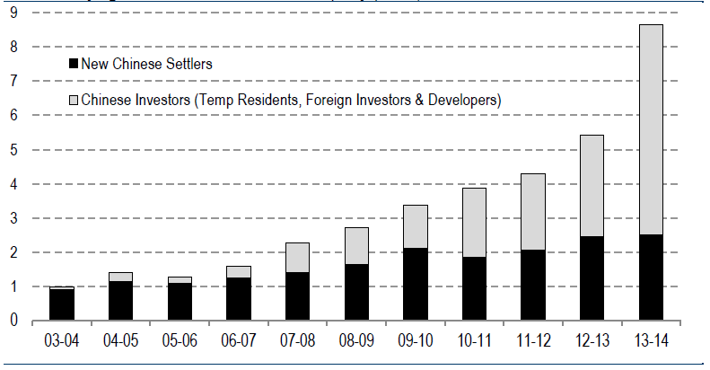
Chinese Purchases of Australian Residential Property
(billions of Australian dollars)
Source: Foreign Investment Review Board, Australian Department of Immigration, Australian Bureau of Statistics, Credit Suisse

Slide 25
Low interest rates and house price appreciation

Slide 26
House Prices and GDP

Slide 27
House Prices and Credit

Slide 28
House Prices and Fiscal Balances

Slide 29
House Prices and Real Interest Rate

Slide 30
Drivers of house prices
Independent Variable | (1) | (2) | (3)
Real GDP (growth) | 0.3 |  | 0.2
Working age population (growth) | 0.1 | 0.1 | 0.1
Short-term interest rate | -0.4 | -0.5 | -0.6
House Price-to-income ratio (lagged) | -0.1 | -0.1 | -0.3
Credit (growth) |  | 0.1 | 0.1
Equity prices (growth) |  | 0.06 | 0.00
Fiscal balance (change) |  |  | -0.1
Constant | 1.1 | 2.3 | 1.5
R-square | 0.28 | 0.30 | 0.39
Number of observations | 3519 | 3148 | 2291

Slide 31
Active use of macroprudential policies

Slide 32
Use of macroprudential policies

Slide 33
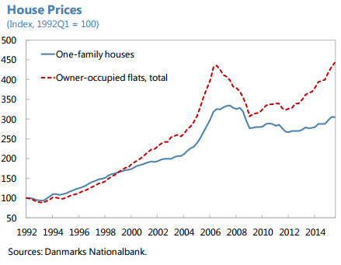
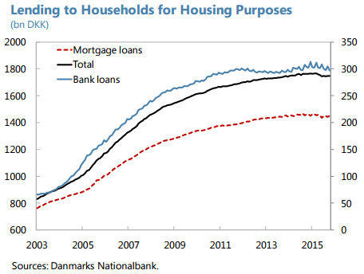
Denmark: Macroprudential Policy
“In view of the emerging risks, macroprudential policies need to play a primary role in safeguarding financial stability. (…) As the Danish economy is still recovering from the last crisis, new measures must be carefully calibrated to balance the benefits of reduced financial stability risks against any negative short-run impact on growth. ”

Slide 34
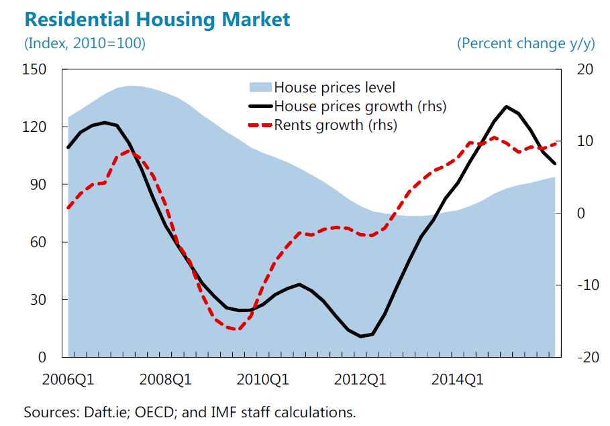
Ireland: Macroprudential Policy
“Residential real estate (RRE) prices and rents continued to increase. Nevertheless, following the abolishment of tax exemptions on capital gains in December 2014 and the introduction of new macroprudential loan-to-value (LTV) and loan-to-income (LTI) limits in February 2015 (…), the market somewhat cooled off: RRE price growth decelerated in late 2015 and the number of mortgage approvals temporarily declined”

Slide 35
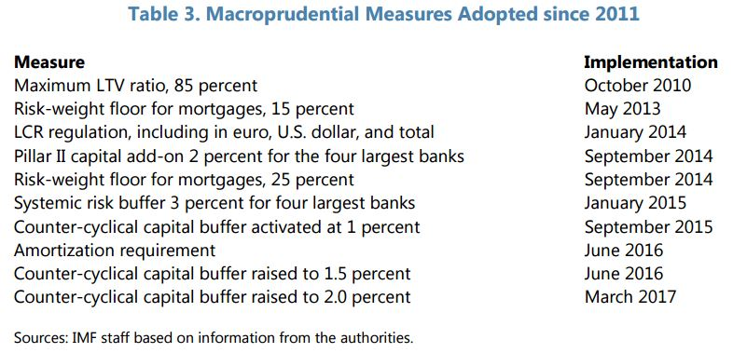
Sweden: Macroprudential Policy

Slide 36
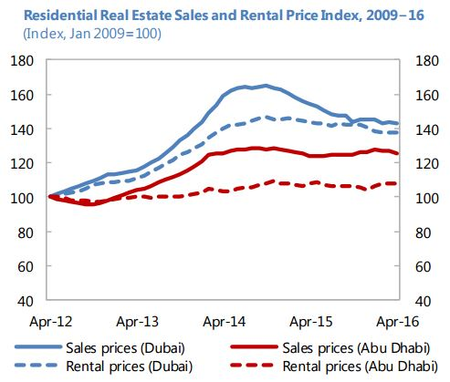
United Arab Emirates: Macroprudential Policy
“Real estate prices have continued to decline, but the quality of the real estate loan portfolio has remained resilient. Structural measures taken in 2014, such as the tightening of industry self-regulation, higher real estate fees, and tighter macroprudential regulation for mortgage lending, have helped contain speculative demand for real estate and led to declining prices.”

Slide 37
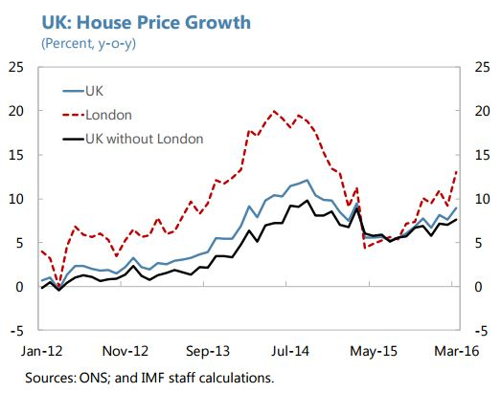
United Kingdom: Macroprudential Policy
“Housing and mortgage markets have re-accelerated since mid-2015 (…) However, the recent acceleration in housing markets could partly be a temporary response to tax changes (…) Macroprudential policies will need to be tightened later this year if the acceleration does not prove temporary (…) ”

Slide 38
Acknowledgments
I am grateful to Hites Ahir for helping me put together this presentation, to Nathalie Gonzalez-Prieto for the empirical work on the drivers of global housing prices, and to Erlend Nier for providing the data on macroprudential policies.
This presentation draws on work by the IMF’s Global Housing Watch team at the IMF, which also includes Richard Koss, Grace Li and Alessandro Rebucci (Johns Hopkins University).
I am grateful to the IMF Housing Markets group for their review of this document.

